Slide 1





Databases & SQL

Slide 2

Hello!
I am Eslam Ahmed
I am a software engineer.
You can find me at jeksogsa@gmail.com

Slide 3
Agenda
What is RDBMS.
Tables, Columns and Data types
How to design a database.
One-To-Many & Many-To-Many Relationships.
Examples: FB, Youtube, Souq.com
SQL
CRUD
Selecting data
Filtering data
Ordering data
Limiting data
Aggregate Functions
Joining tables
Grouping data
Subqueries
Inserting new data
Updating data
Deleting data
Python and SQLite
DB Browser for SQLite

Slide 4
Agenda
What is RDBMS.
Tables, Columns and Data types
How to design a database.
One-To-Many & Many-To-Many Relationships.
Examples: FB, Youtube, Souq.com
SQL
CRUD
Selecting data
Filtering data
Ordering data
Limiting data
Aggregate Functions
Joining tables
Grouping data
Subqueries
Inserting new data
Updating data
Deleting data
Python and SQLite
DB Browser for SQLite

Slide 5
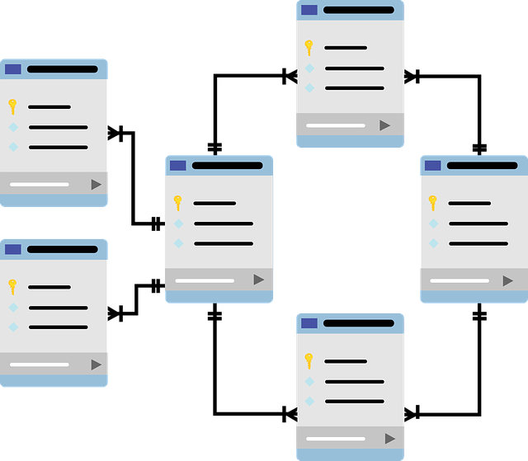
What is RDBMS.
File systems made for storing and
manipulating relational data.
Data organized in tabular form each
table represents an entity like users,
products, categories, etc…
Each table consists of columns that
represent entity properties, each
column can be any data type like
numbers, text, etc…
SQL is an easy language to connect
With database and query the data
from it easily.

Slide 6
Agenda
What is RDBMS.
Tables, Columns and Data types
How to design a database.
One-To-Many & Many-To-Many Relationships.
Examples: FB, Youtube, Souq.com
SQL
CRUD
Selecting data
Filtering data
Ordering data
Limiting data
Aggregate Functions
Joining tables
Grouping data
Subqueries
Inserting new data
Updating data
Deleting data
Python and SQLite
DB Browser for SQLite

Slide 7
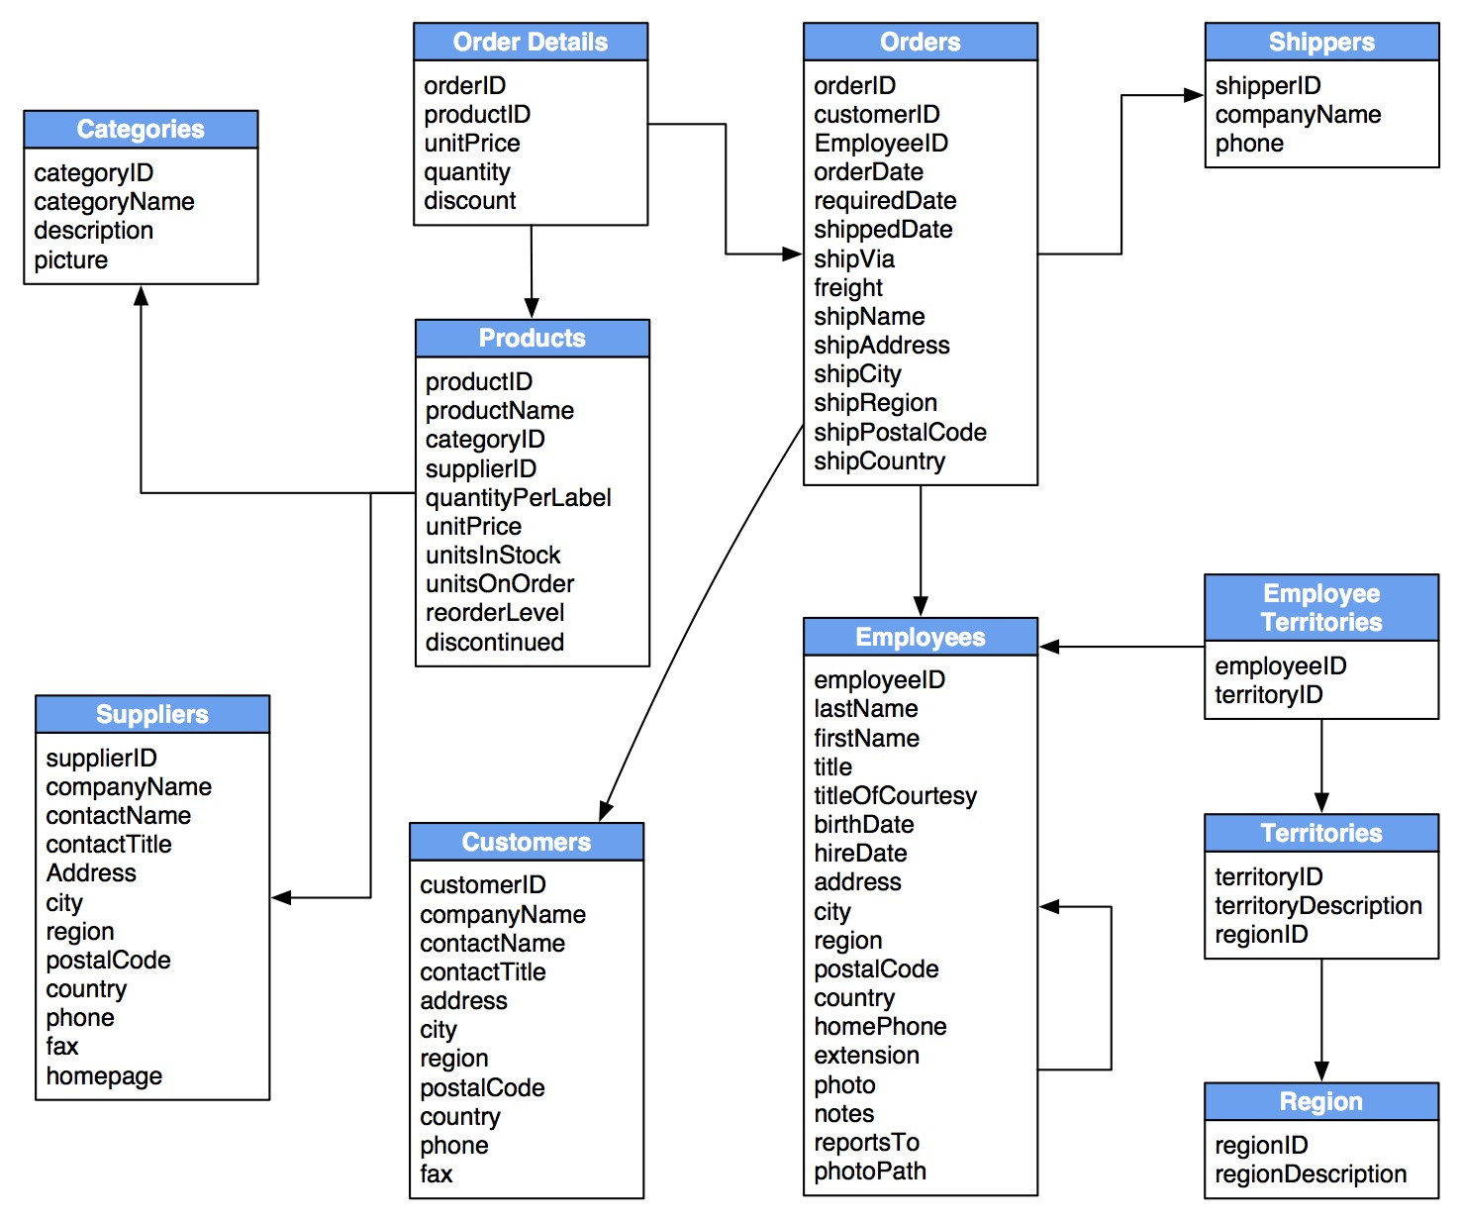



Tables, Columns and Data types
Tables
Users, posts, comments, products, …
Columns
Users table have columns like age,
gender, username, email, is_online,…
Data Types
Age is Numeric, username is TEXT
Gender is CHAR, is_online is BOOL

Slide 8
Agenda
What is RDBMS.
Tables, Columns and Data types
How to design a database.
One-To-Many & Many-To-Many Relationships.
Examples: FB, Youtube, Souq.com
SQL
CRUD
Selecting data
Filtering data
Ordering data
Limiting data
Aggregate Functions
Joining tables
Grouping data
Subqueries
Inserting new data
Updating data
Deleting data
Python and SQLite
DB Browser for SQLite

Slide 9
How to design a database.
1) Analyze the system and divide it to its main entities (tables).
-------------------------------------------------------
for example we make an ecommerce system so the main entities tables are Categories, Products, Orders, Customers, etc…
2) For each table define what its properties (columns) are and what is their data types.
-------------------------------------------------------------
for example customers table have name, city , phone and products table have price, name, etc.., the most important thing don’t forget to add the unique auto increment id column (Primary Key) because it’s the row identifier.
3) Define tables relationships and based on the relationship define the foreign keys.
------------------------------------------------------------
for example one-to-many relationship between the products and categories tables so we define the CategoryID column (Foreign Key) in the products table, another relation is many-to-many relation between orders and products tables so we make Order Details table that contain the foreign keys

Slide 10
Agenda
What is RDBMS.
Tables, Columns and Data types
How to design a database.
One-To-Many & Many-To-Many Relationships.
Examples: FB, Youtube, Souq.com
SQL
CRUD
Selecting data
Filtering data
Ordering data
Limiting data
Aggregate Functions
Joining tables
Grouping data
Subqueries
Inserting new data
Updating data
Deleting data
Python and SQLite
DB Browser for SQLite

Slide 11
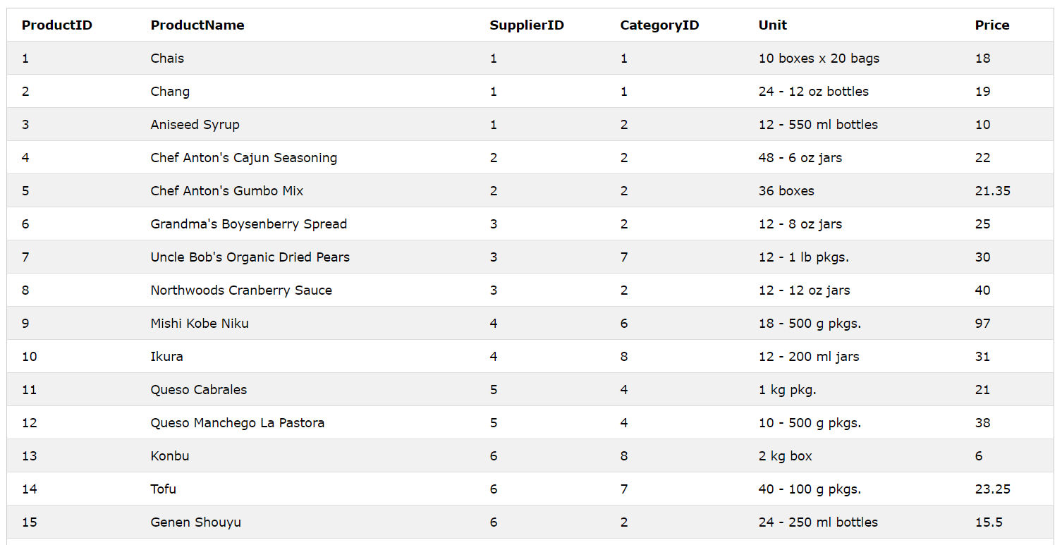
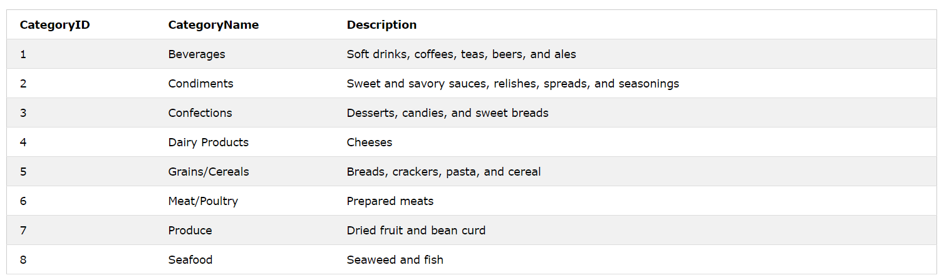
One-To-Many & Many-To-Many Relationships
Products --->
CategoryID is a foreign key that point to the CategoryID primary key in categories table
<--- Categories
CategoryID is a primary key

Slide 12

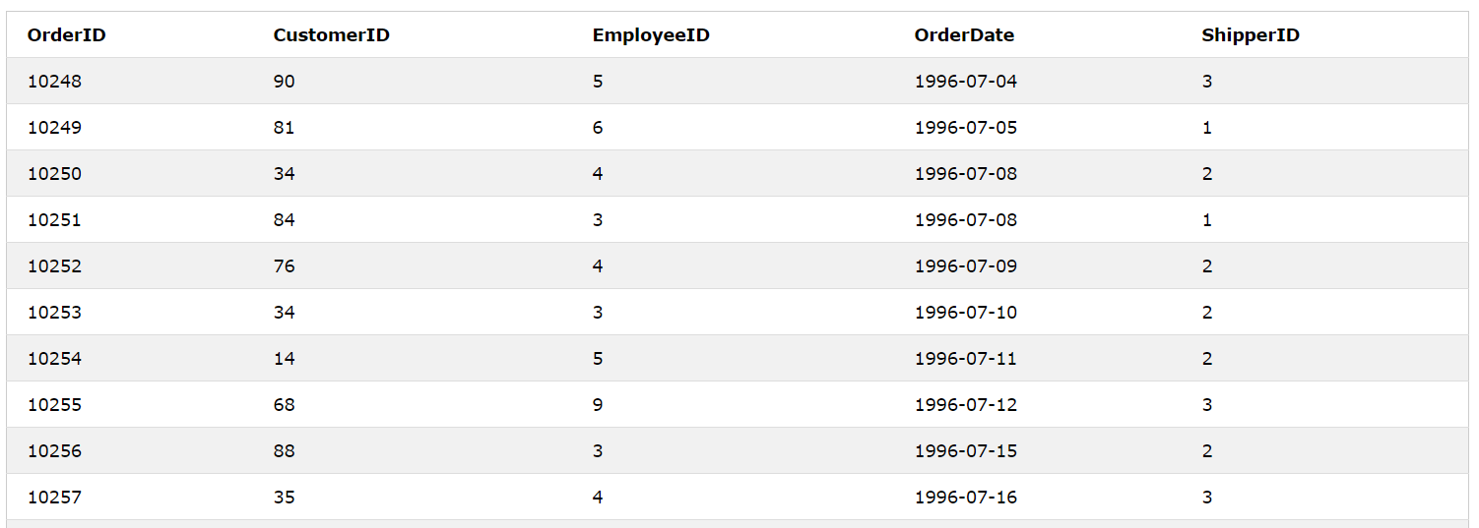
One-To-Many & Many-To-Many Relationships
Products --->
How can we represent the relationship ?!
Orders --->

Slide 13
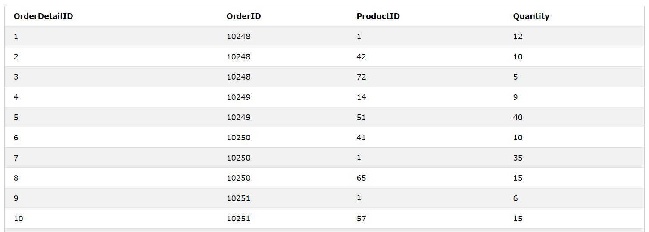
Products
One-To-Many & Many-To-Many Relationships
Order Details
Orders
We make a new table that have both foreign keys

Slide 14
Agenda
What is RDBMS.
Tables, Columns and Data types
How to design a database.
One-To-Many & Many-To-Many Relationships.
Examples: FB, Youtube, Souq.com
SQL
CRUD
Selecting data
Filtering data
Ordering data
Limiting data
Aggregate Functions
Joining tables
Grouping data
Subqueries
Inserting new data
Updating data
Deleting data
Python and SQLite
DB Browser for SQLite

Slide 15



Examples: FB, Youtube, Souq.com

Slide 16
Agenda
What is RDBMS.
Tables, Columns and Data types
How to design a database.
One-To-Many & Many-To-Many Relationships.
Examples: FB, Youtube, Souq.com
SQL
CRUD
Selecting data
Filtering data
Ordering data
Limiting data
Aggregate Functions
Joining tables
Grouping data
Subqueries
Inserting new data
Updating data
Deleting data
Python and SQLite
DB Browser for SQLite

Slide 17

SQL
SQL or Structured Query Language used to communicate with the database by executing commands for creating tables and columns and also reading, filtering, ordering, inserting, updating, deleting data and more.
You can try SQL on bunch of examples from this link
https://www.w3schools.com/sql/default.asp
https://www.sqlitetutorial.net

Slide 18
Agenda
What is RDBMS.
Tables, Columns and Data types
How to design a database.
One-To-Many & Many-To-Many Relationships.
Examples: FB, Youtube, Souq.com
SQL
CRUD
Selecting data
Filtering data
Ordering data
Limiting data
Aggregate Functions
Joining tables
Grouping data
Subqueries
Inserting new data
Updating data
Deleting data
Python and SQLite
DB Browser for SQLite

Slide 19
CRUD
C R U D
Create
Read
Update
Delete

Slide 20
Agenda
What is RDBMS.
Tables, Columns and Data types
How to design a database.
One-To-Many & Many-To-Many Relationships.
Examples: FB, Youtube, Souq.com
SQL
CRUD
Selecting data
Filtering data
Ordering data
Limiting data
Aggregate Functions
Joining tables
Grouping data
Subqueries
Inserting new data
Updating data
Deleting data
Python and SQLite
DB Browser for SQLite

Slide 21
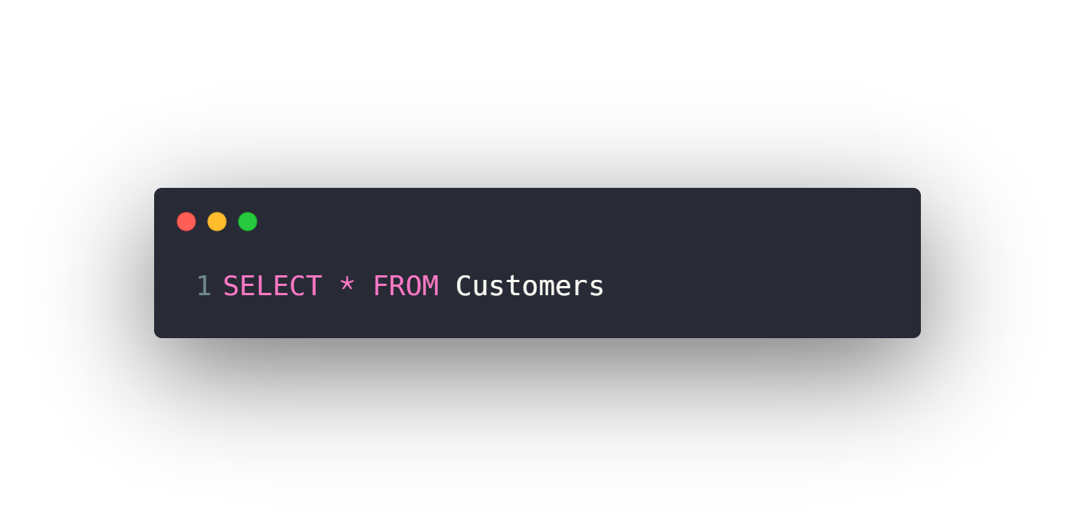
Selecting data
Select all columns from a table
Select specific columns from a table

Slide 22
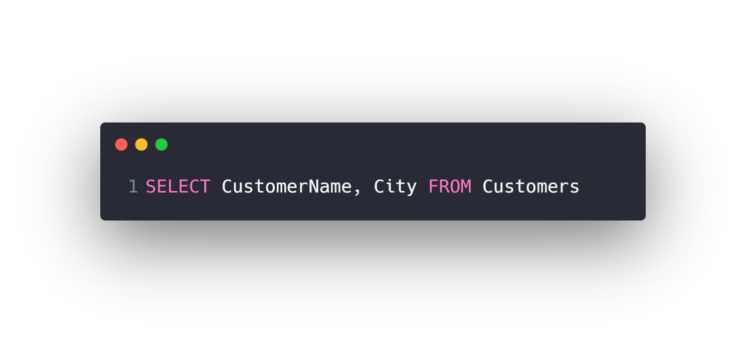
Selecting data
Select all columns from a table
Select specific columns from a table

Slide 23
Agenda
What is RDBMS.
Tables, Columns and Data types
How to design a database.
One-To-Many & Many-To-Many Relationships.
Examples: FB, Youtube, Souq.com
SQL
CRUD
Selecting data
Filtering data
Ordering data
Limiting data
Aggregate Functions
Joining tables
Grouping data
Subqueries
Inserting new data
Updating data
Deleting data
Python and SQLite
DB Browser for SQLite

Slide 24
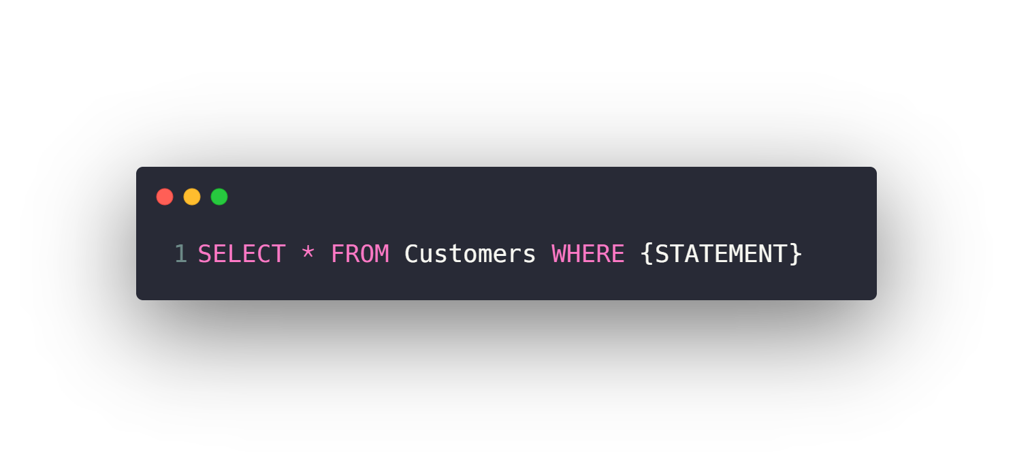
Filtering data
WHERE Clause
Filtering with Text vs Numeric Fields
Comparison operators (>, <, >=, <=, =, <>)
BETWEEN
IN
LIKE
Logic operators (AND, OR, NOT)
IS NULL, IS NOT NULL

Slide 25
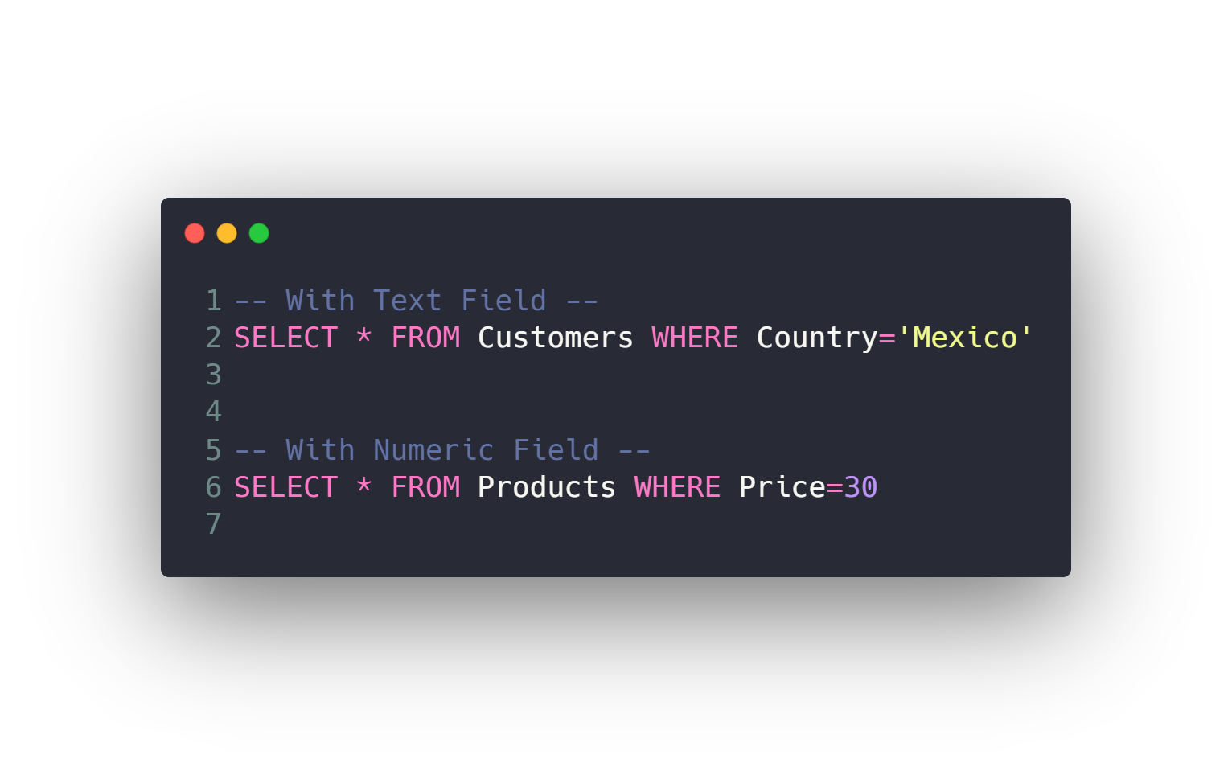
Filtering data
WHERE Clause
Filtering with Text vs Numeric Fields
Comparison operators (>, <, >=, <=, =, <>)
BETWEEN
IN
LIKE
Logic operators (AND, OR, NOT)
IS NULL, IS NOT NULL

Slide 26
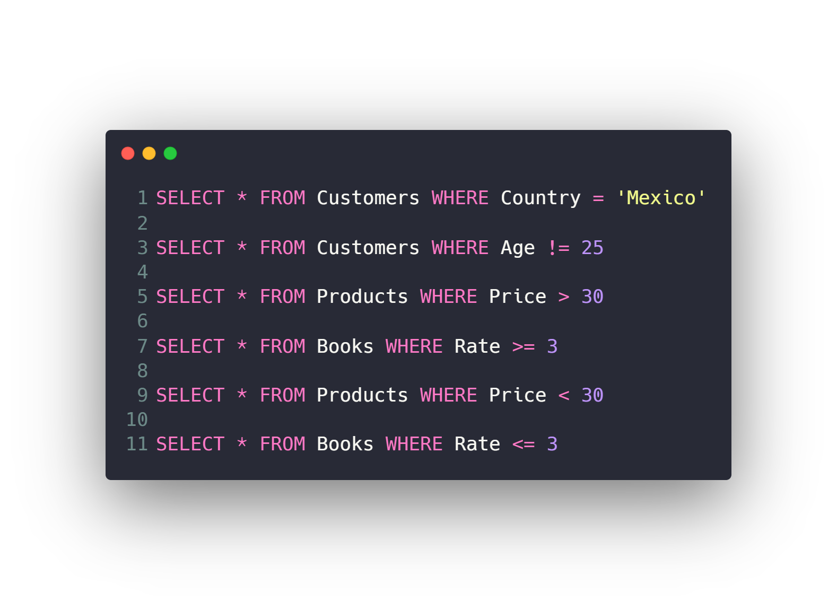
Filtering data
WHERE Clause
Filtering with Text vs Numeric Fields
Comparison operators (=, !=, >, <, >=, <=)
BETWEEN
IN
LIKE
Logic operators (AND, OR, NOT)
IS NULL, IS NOT NULL

Slide 27
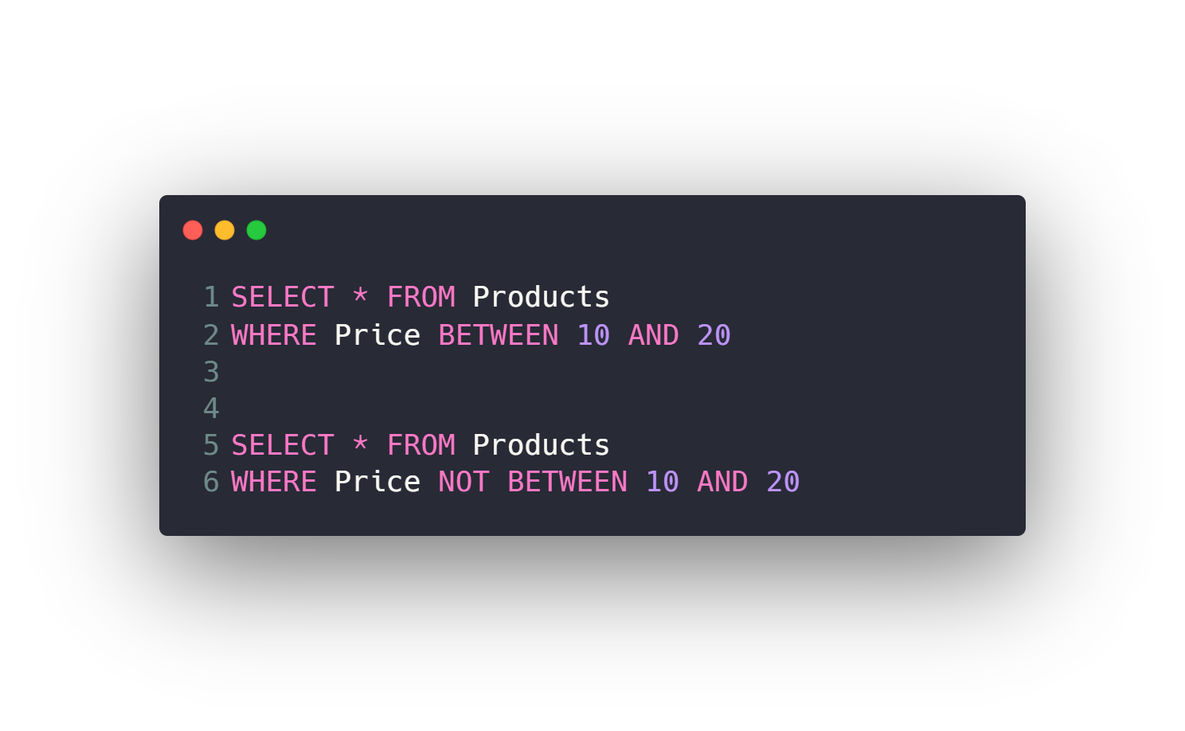
Filtering data
WHERE Clause
Filtering with Text vs Numeric Fields
Comparison operators (=, !=, >, <, >=, <=)
BETWEEN
IN
LIKE
Logic operators (AND, OR, NOT)
IS NULL, IS NOT NULL

Slide 28
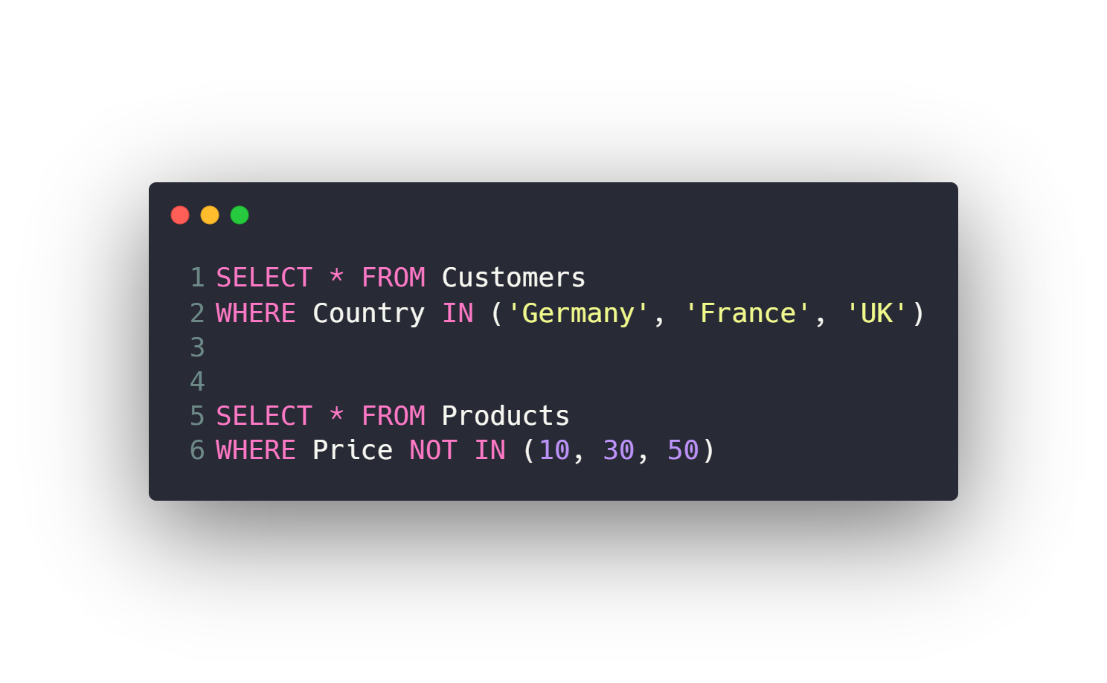
Filtering data
WHERE Clause
Filtering with Text vs Numeric Fields
Comparison operators (=, !=, >, <, >=, <=)
BETWEEN
IN
LIKE
Logic operators (AND, OR, NOT)
IS NULL, IS NOT NULL

Slide 29
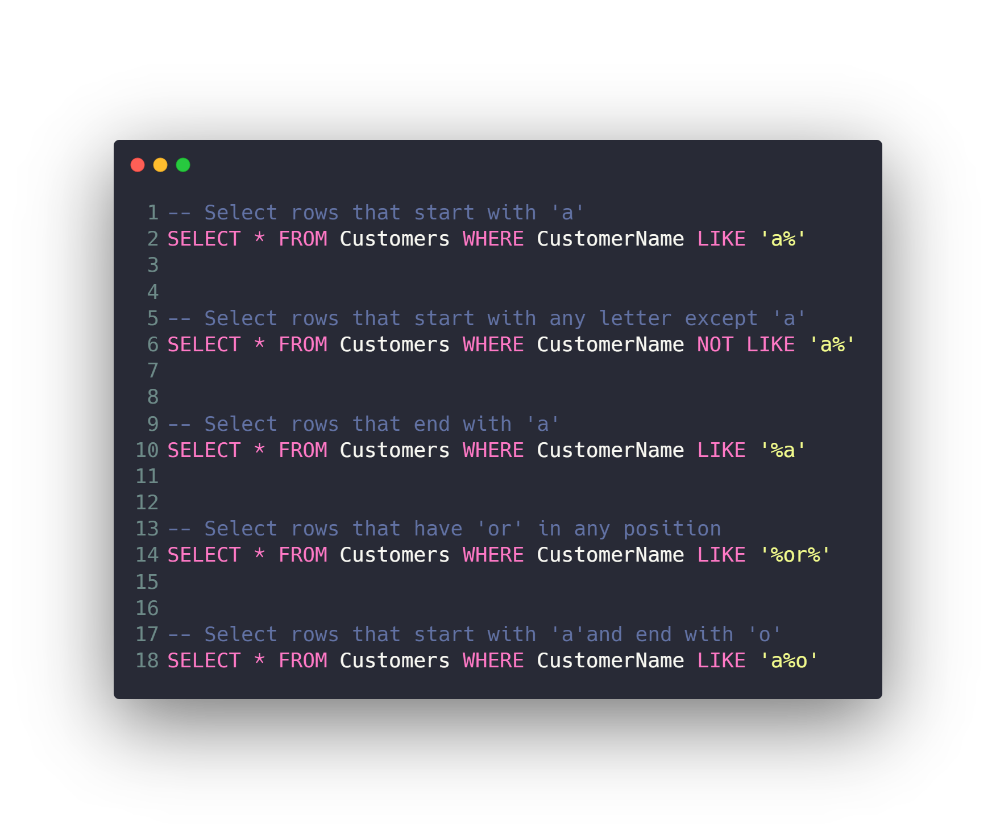
Filtering data
WHERE Clause
Filtering with Text vs Numeric Fields
Comparison operators (=, !=, >, <, >=, <=)
BETWEEN
IN
LIKE
Logic operators (AND, OR, NOT)
IS NULL, IS NOT NULL

Slide 30
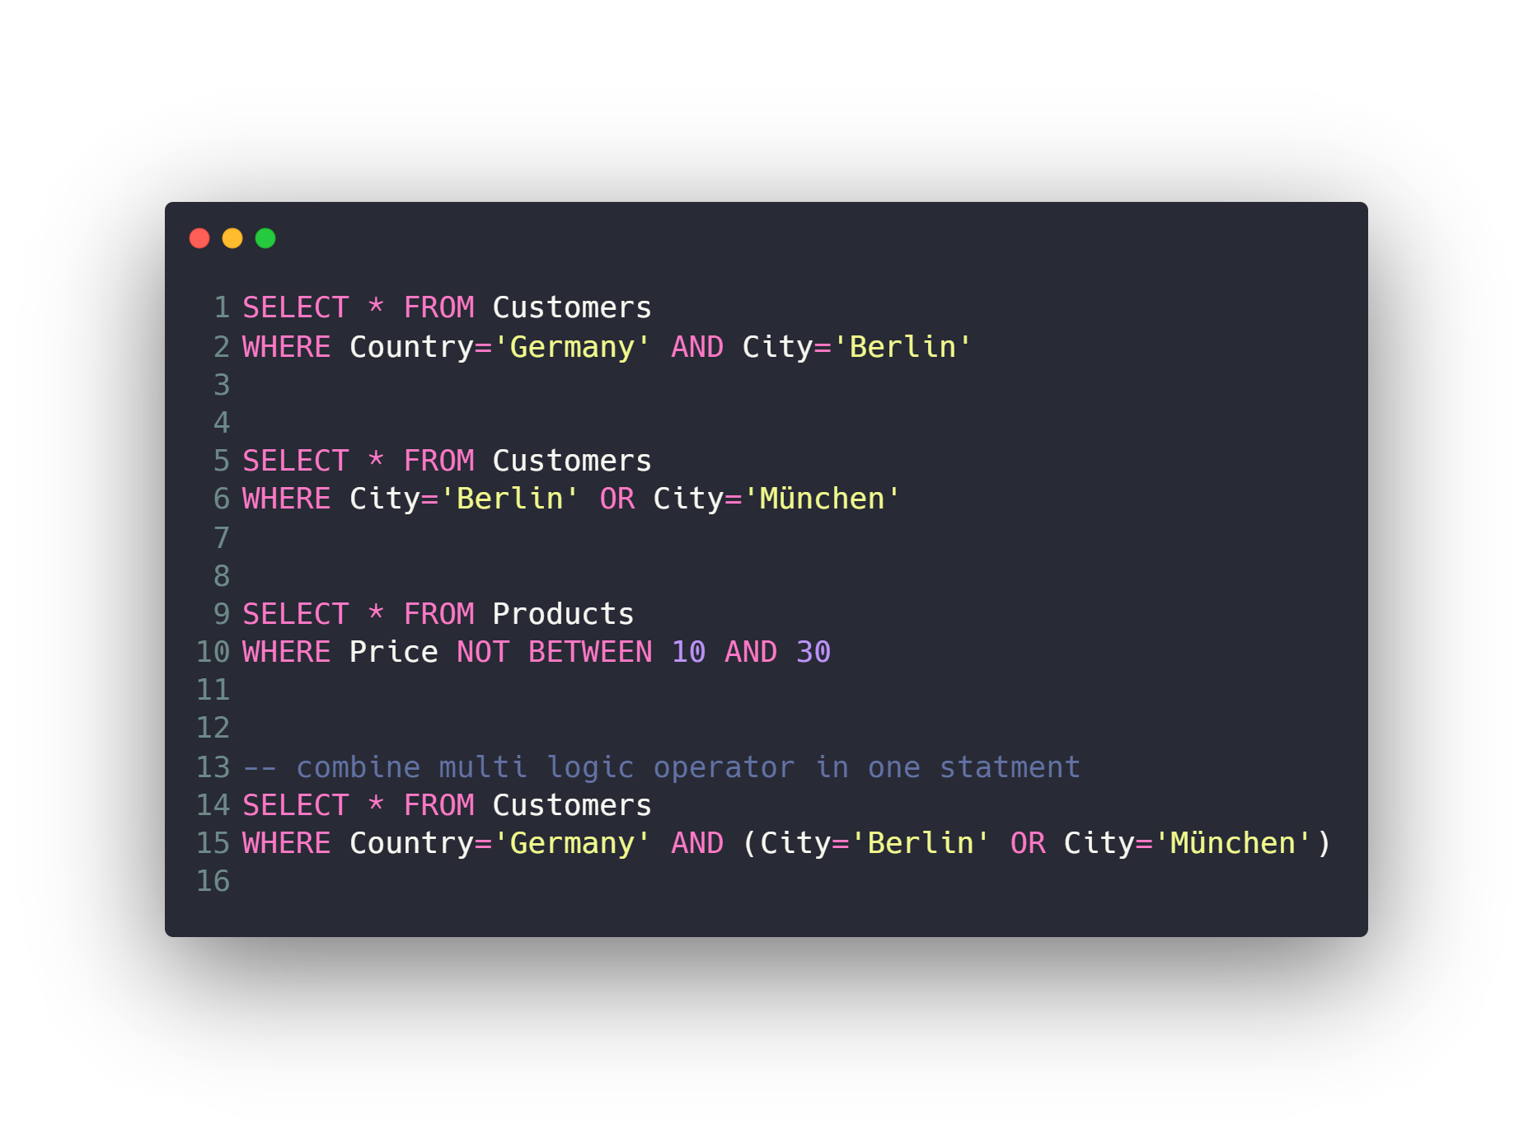
Filtering data
WHERE Clause
Filtering with Text vs Numeric Fields
Comparison operators (=, !=, >, <, >=, <=)
BETWEEN
IN
LIKE
Logic operators (AND, OR, NOT)
IS NULL, IS NOT NULL

Slide 31
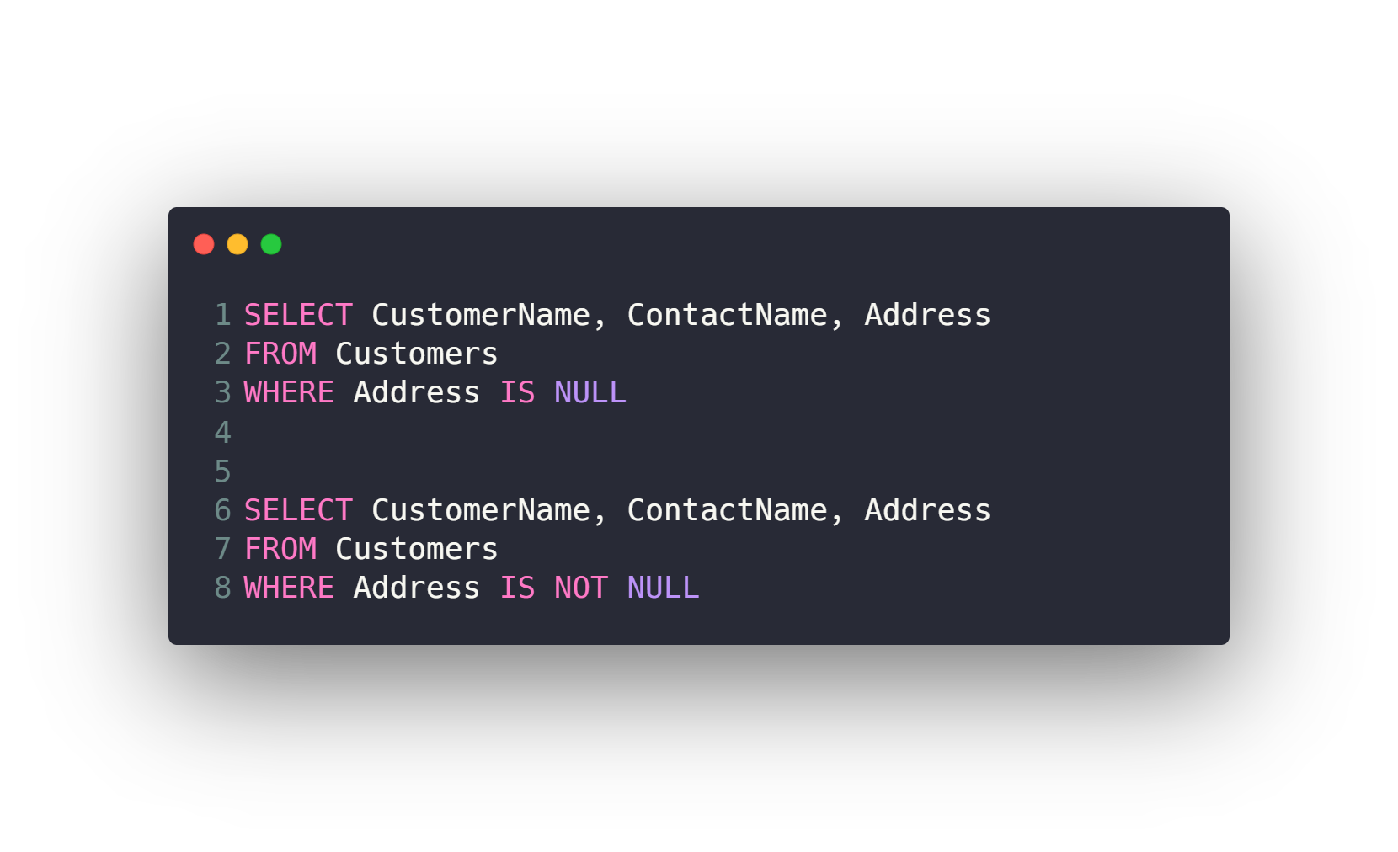
Filtering data
WHERE Clause
Filtering with Text vs Numeric Fields
Comparison operators (=, !=, >, <, >=, <=)
BETWEEN
IN
LIKE
Logic operators (AND, OR, NOT)
IS NULL, IS NOT NULL

Slide 32
Agenda
What is RDBMS.
Tables, Columns and Data types
How to design a database.
One-To-Many & Many-To-Many Relationships.
Examples: FB, Youtube, Souq.com
SQL
CRUD
Selecting data
Filtering data
Ordering data
Limiting data
Aggregate Functions
Joining tables
Grouping data
Subqueries
Inserting new data
Updating data
Deleting data
Python and SQLite
DB Browser for SQLite

Slide 33
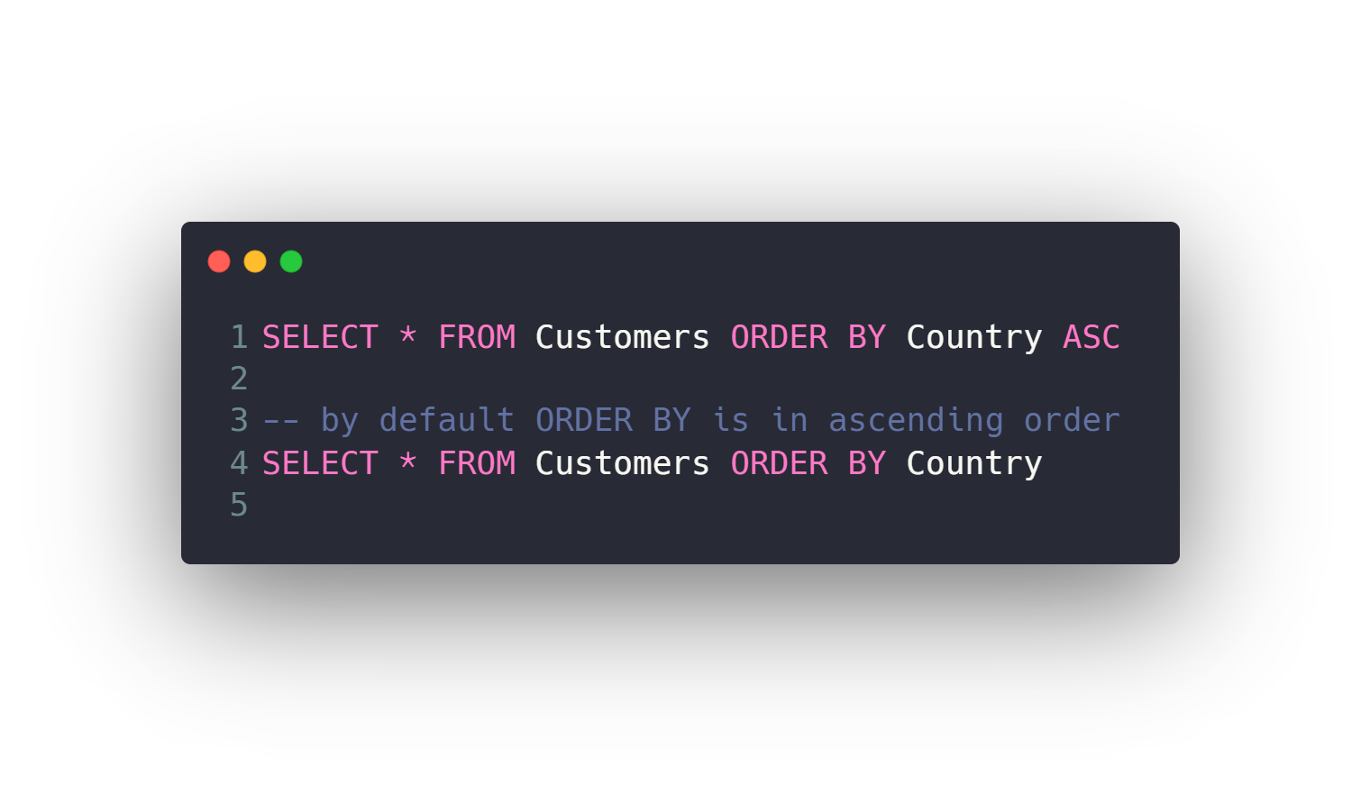
Ordering data
Order rows by single column ascending
Order rows by single column descending
Filter then Order
Order rows by several columns

Slide 34
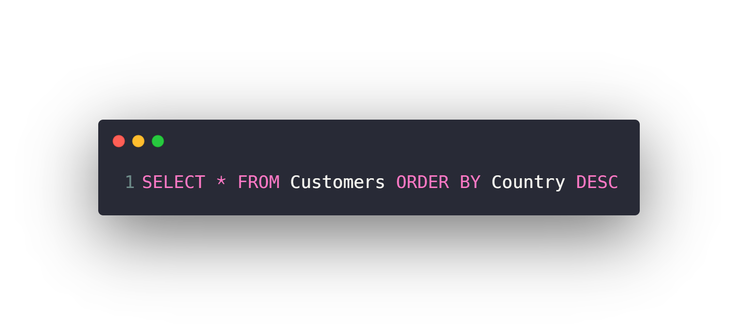
Ordering data
Order rows by single column ascending
Order rows by single column descending
Filter then Order
Order rows by several columns

Slide 35
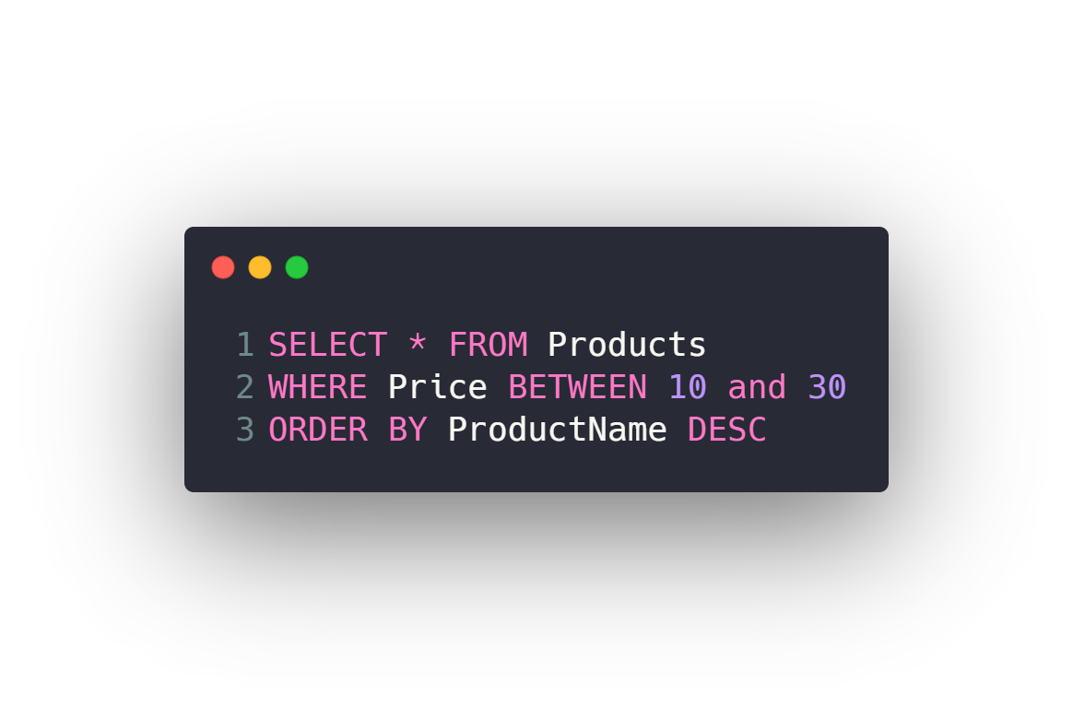
Ordering data
Order rows by single column ascending
Order rows by single column descending
Filter then Order
Order rows by several columns

Slide 36
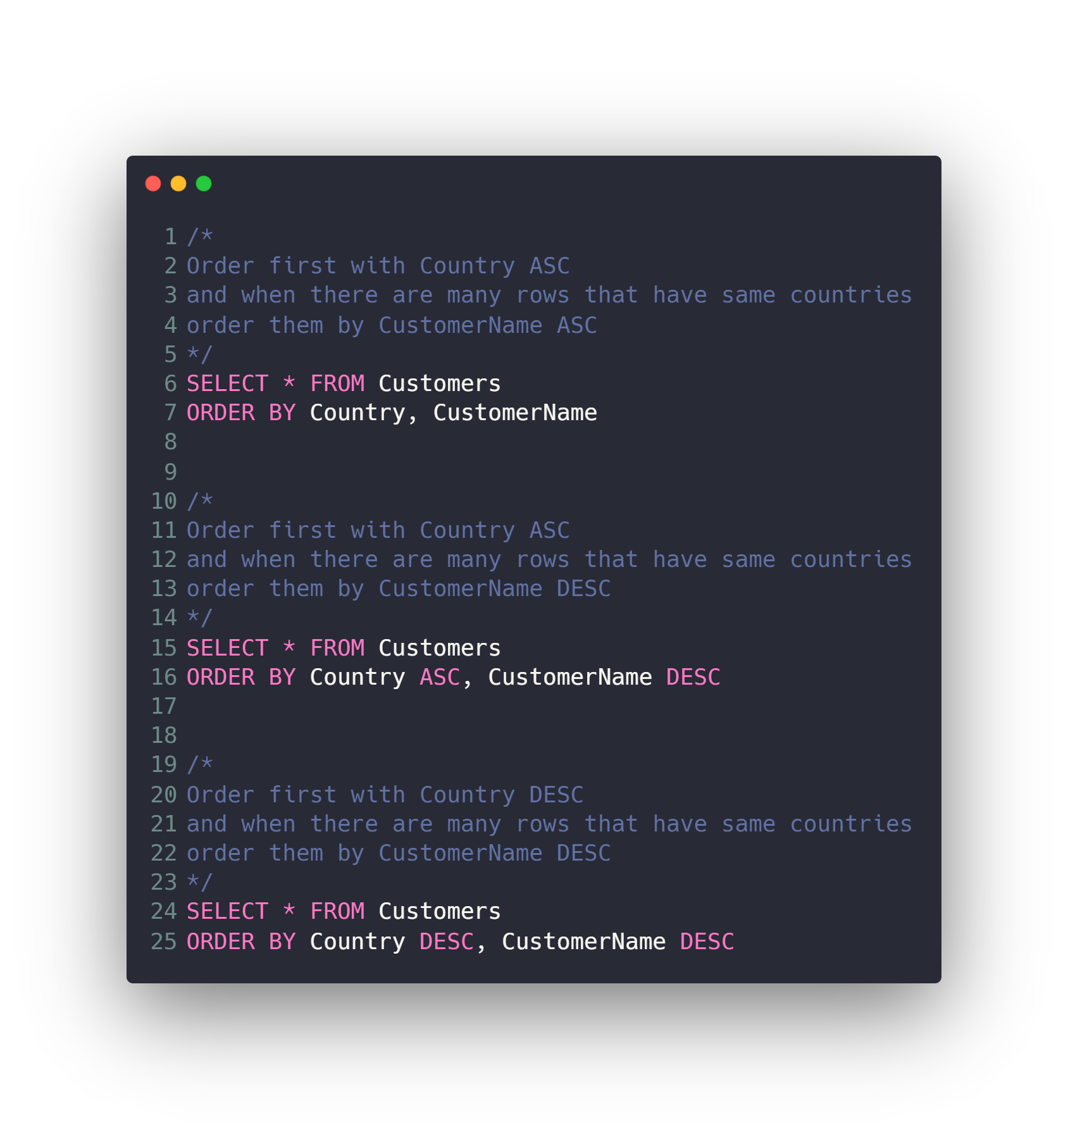
Ordering data
Order rows by single column ascending
Order rows by single column descending
Filter then Order
Order rows by several columns

Slide 37
Agenda
What is RDBMS.
Tables, Columns and Data types
How to design a database.
One-To-Many & Many-To-Many Relationships.
Examples: FB, Youtube, Souq.com
SQL
CRUD
Selecting data
Filtering data
Ordering data
Limiting data
Aggregate Functions
Joining tables
Grouping data
Subqueries
Inserting new data
Updating data
Deleting data
Python and SQLite
DB Browser for SQLite

Slide 38
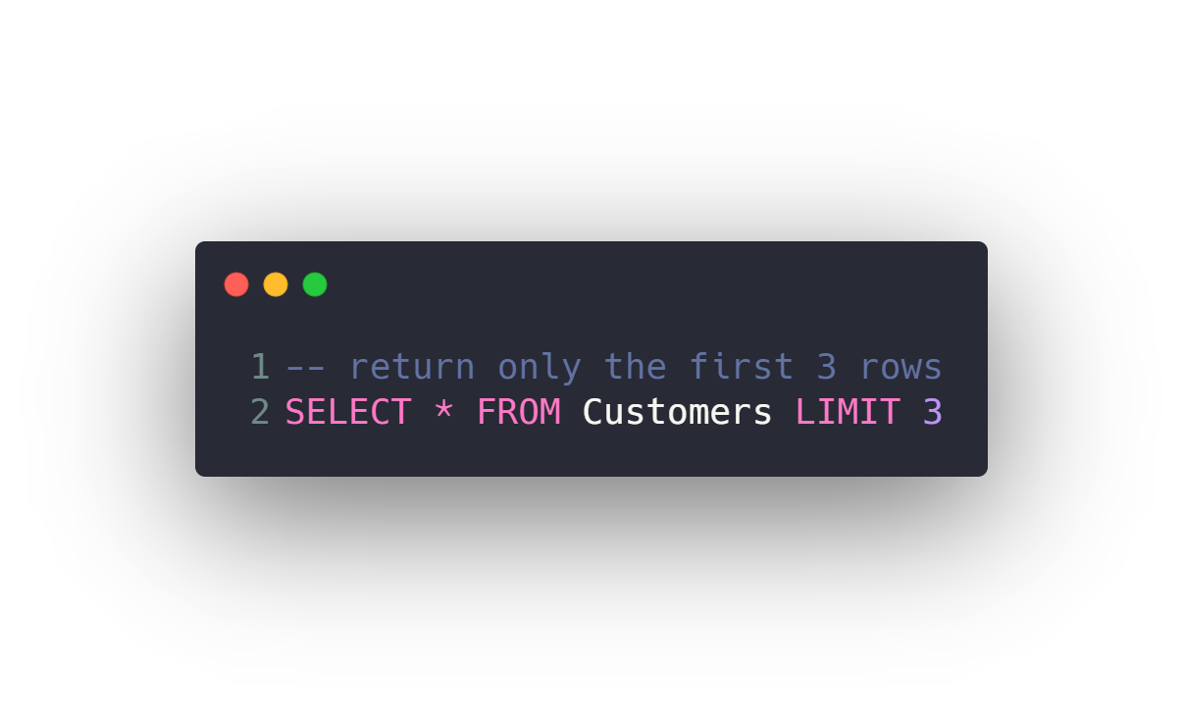
Limiting data
Limit resulted rows to a specific number from first row
Limit resulted rows to a specific number from a specific offset row

Slide 39
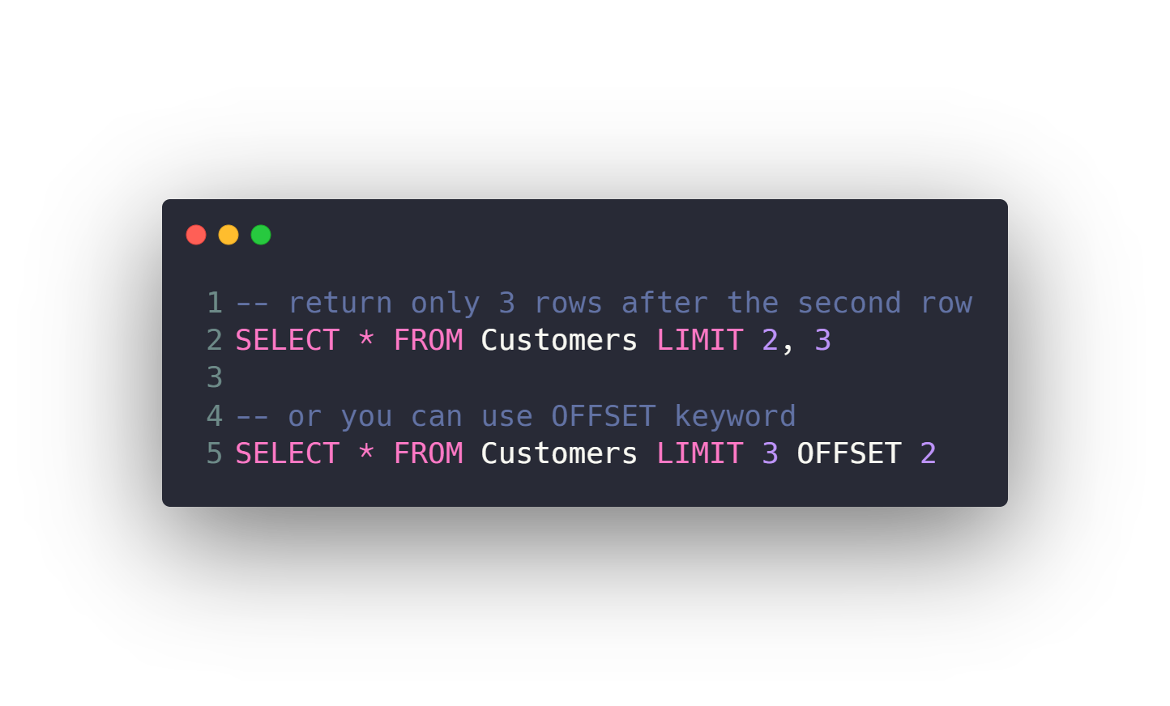
Limiting data
Limit resulted rows to a specific number from first row
Limit resulted rows to a specific number from a specific offset row

Slide 40
Agenda
What is RDBMS.
Tables, Columns and Data types
How to design a database.
One-To-Many & Many-To-Many Relationships.
Examples: FB, Youtube, Souq.com
SQL
CRUD
Selecting data
Filtering data
Ordering data
Limiting data
Aggregate Functions
Joining tables
Grouping data
Subqueries
Inserting new data
Updating data
Deleting data
Python and SQLite
DB Browser for SQLite

Slide 41
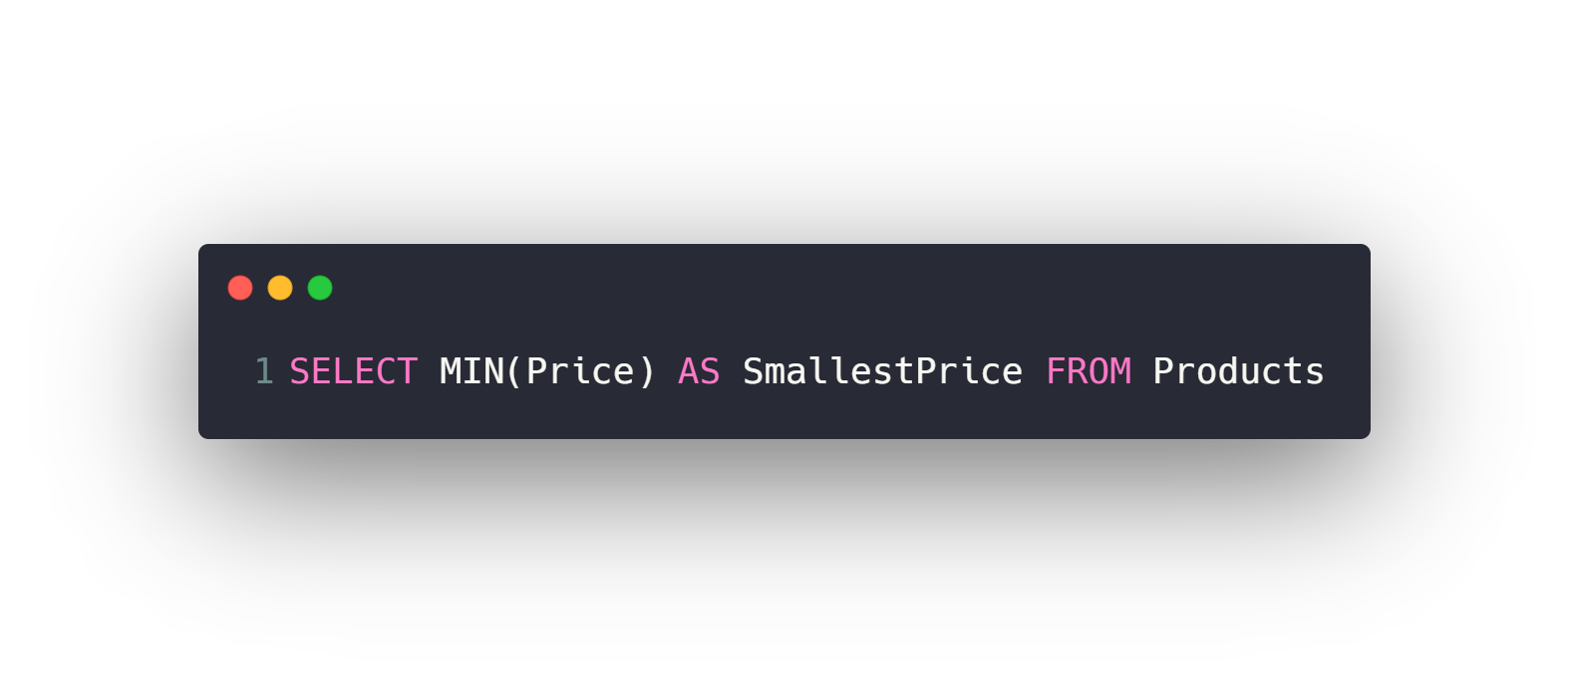
Aggregate Functions
MIN
MAX
COUNT
AVG
SUM

Slide 42
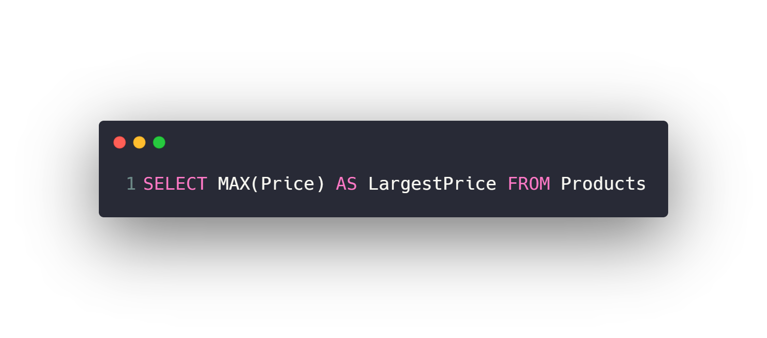
Aggregate Functions
MIN
MAX
COUNT
AVG
SUM

Slide 43
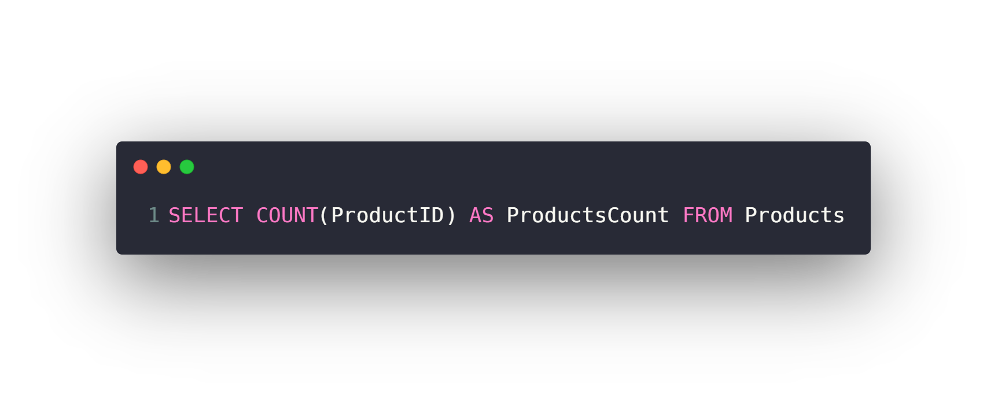
Aggregate Functions
MIN
MAX
COUNT
AVG
SUM

Slide 44
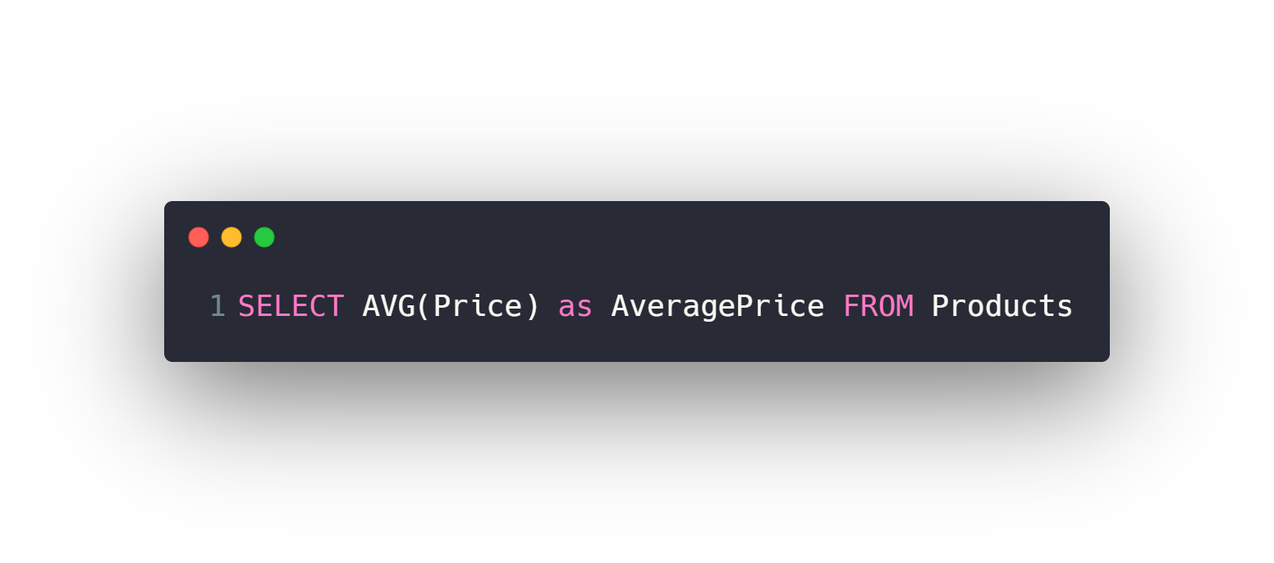
Aggregate Functions
MIN
MAX
COUNT
AVG
SUM

Slide 45
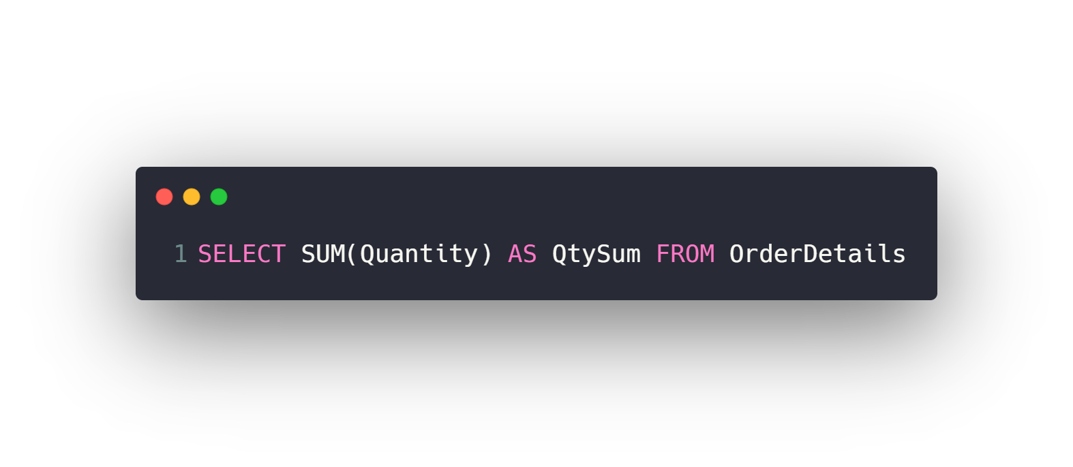
Aggregate Functions
MIN
MAX
COUNT
AVG
SUM

Slide 46
Agenda
What is RDBMS.
Tables, Columns and Data types
How to design a database.
One-To-Many & Many-To-Many Relationships.
Examples: FB, Youtube, Souq.com
SQL
CRUD
Selecting data
Filtering data
Ordering data
Limiting data
Aggregate Functions
Joining tables
Grouping data
Subqueries
Inserting new data
Updating data
Deleting data
Python and SQLite
DB Browser for SQLite

Slide 47
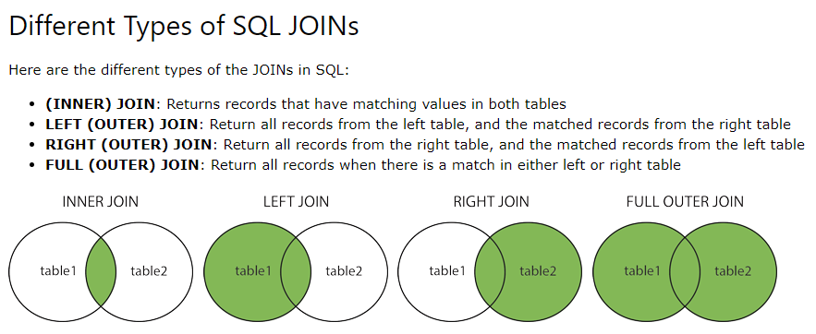
Joining tables

Slide 48
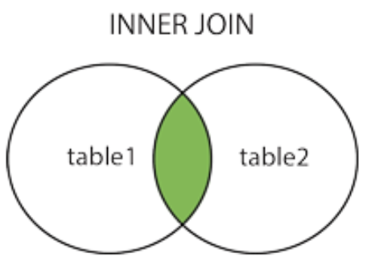
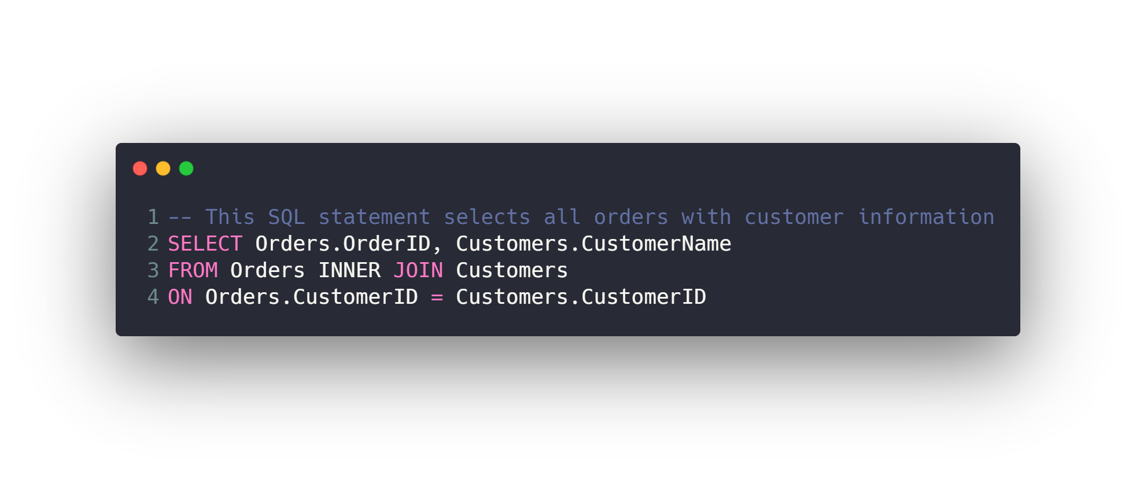
Joining tables (INNER)
The INNER JOIN keyword selects all rows from both tables as long
as there is a match between the columns. If there are records in
the "Orders" table that do not have matches in "Customers“,
these orders will not be shown!

Slide 49
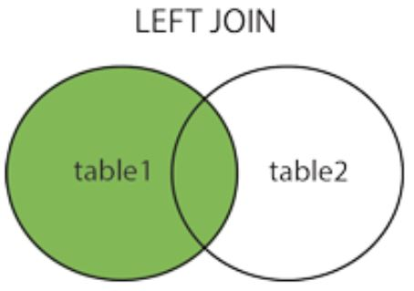
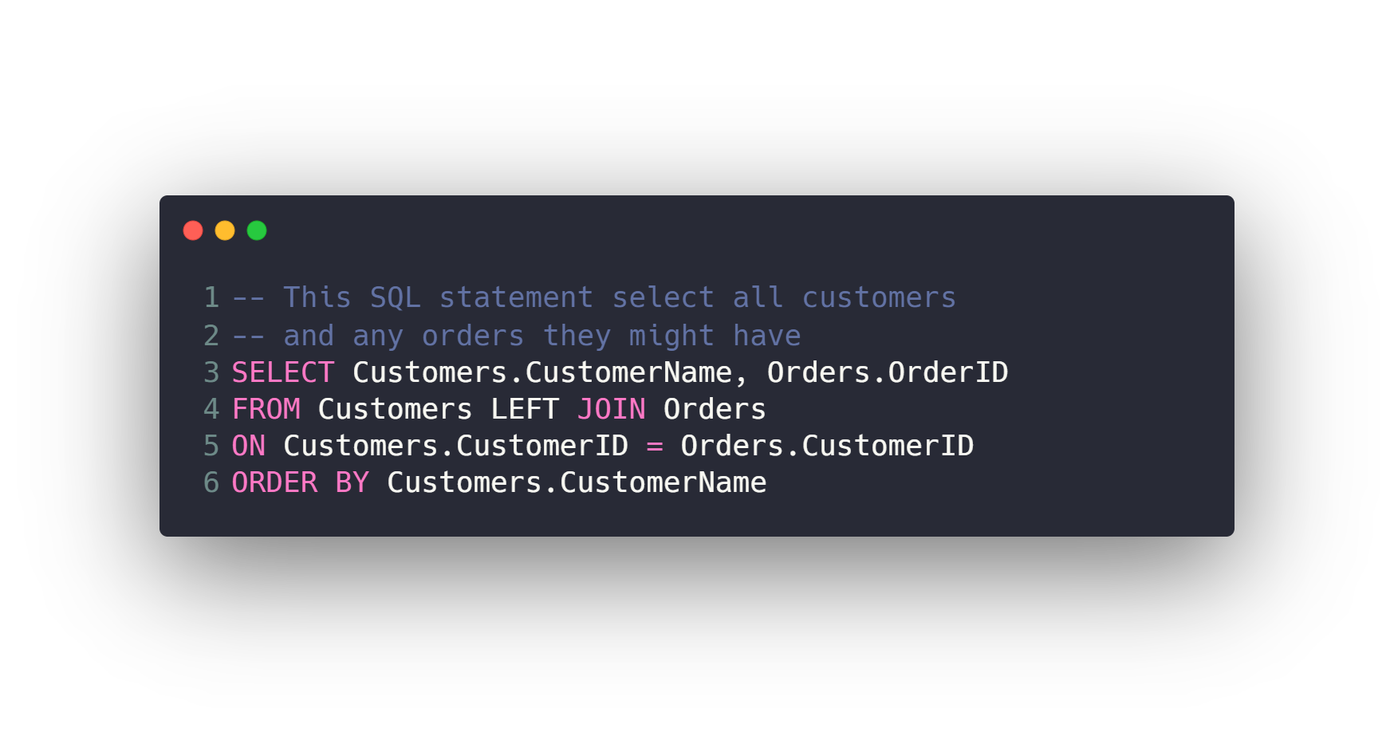
Joining tables (LEFT)
The LEFT JOIN keyword returns all records from the
left table (Customers), and the matched records from the
right table (Orders). The result is NULL from the right side,
if there is no match.

Slide 50
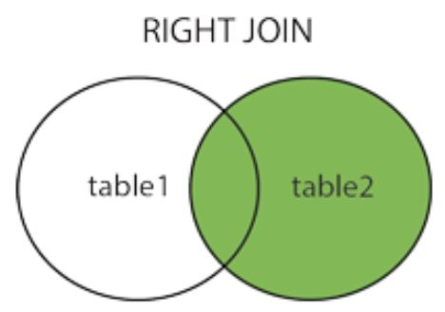
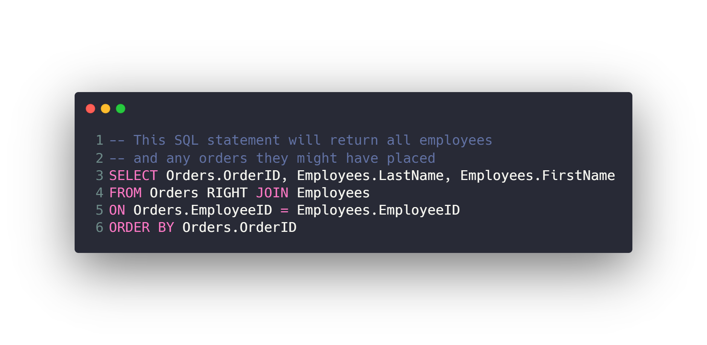
Joining tables (RIGHT)
The RIGHT JOIN keyword returns all records from the
right table (Employees), and the matched records from the
left table (Orders). The result is NULL from the
left side, when there is no match.

Slide 51
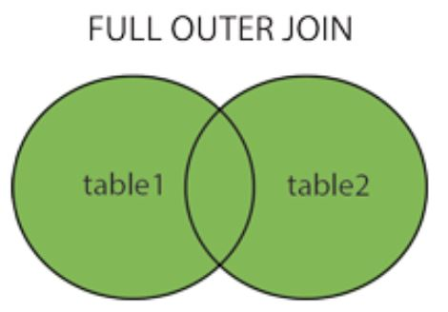
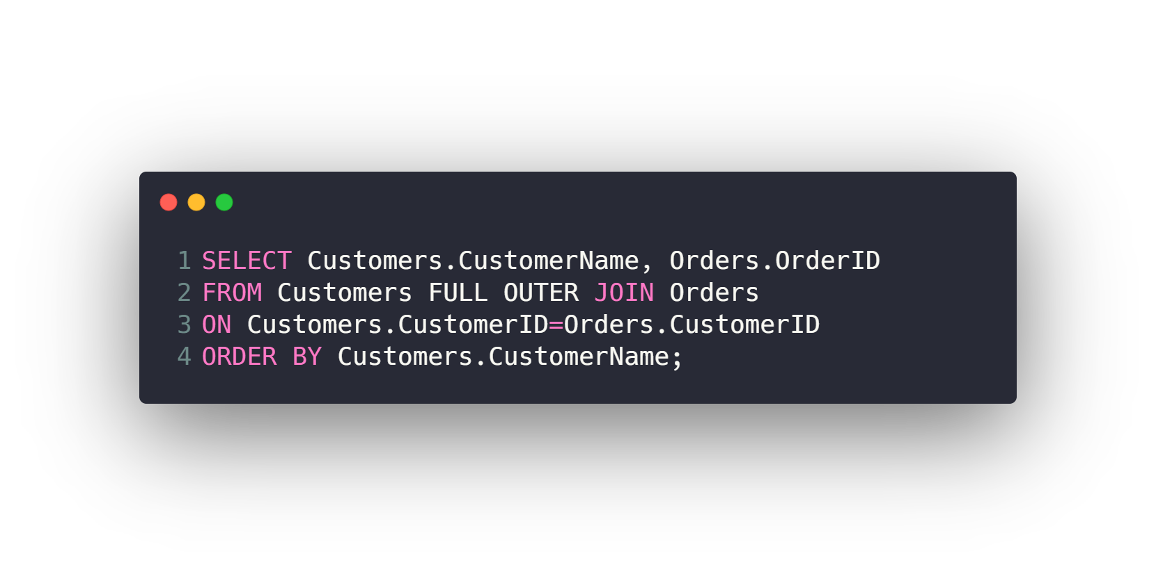
Joining tables (FULL)
The FULL OUTER JOIN keyword returns all matching records
from both tables whether the other table matches or not.
So, if there are rows in "Customers" that do not have matches
in "Orders", or if there are rows in "Orders" that do not have
matches in "Customers", those rows will be listed as
well with NULL

Slide 52
Agenda
What is RDBMS.
Tables, Columns and Data types
How to design a database.
One-To-Many & Many-To-Many Relationships.
Examples: FB, Youtube, Souq.com
SQL
CRUD
Selecting data
Filtering data
Ordering data
Limiting data
Aggregate Functions
Joining tables
Grouping data
Subqueries
Inserting new data
Updating data
Deleting data
Python and SQLite
DB Browser for SQLite

Slide 53
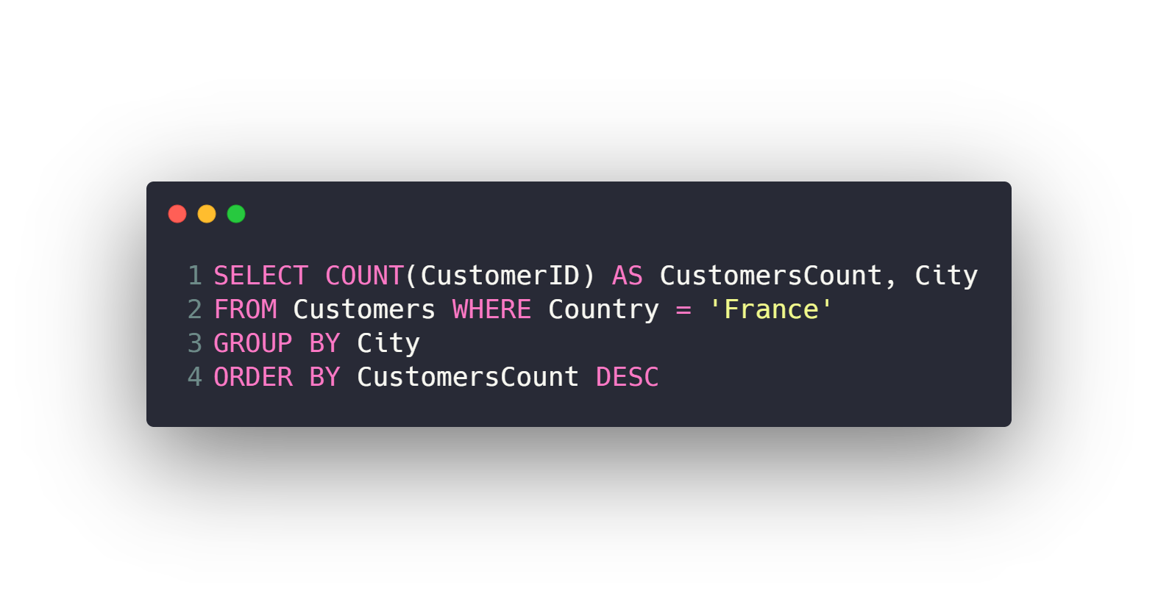
Grouping data
GROUP BY
HAVING

Slide 54
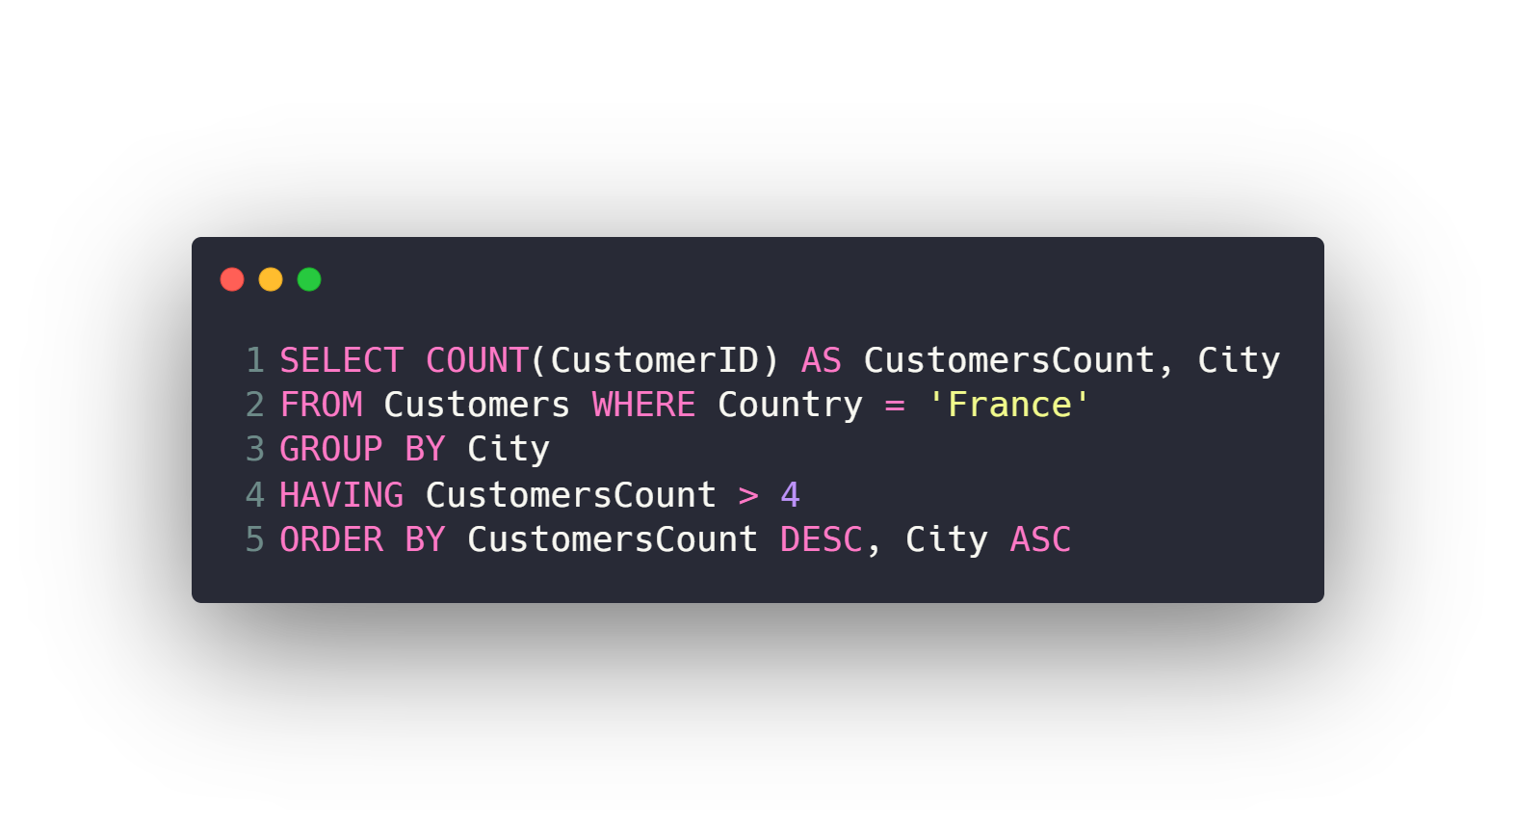
Grouping data
GROUP BY
HAVING

Slide 55
Agenda
What is RDBMS.
Tables, Columns and Data types
How to design a database.
One-To-Many & Many-To-Many Relationships.
Examples: FB, Youtube, Souq.com
SQL
CRUD
Selecting data
Filtering data
Ordering data
Limiting data
Aggregate Functions
Joining tables
Grouping data
Subqueries
Inserting new data
Updating data
Deleting data
Python and SQLite
DB Browser for SQLite

Slide 56
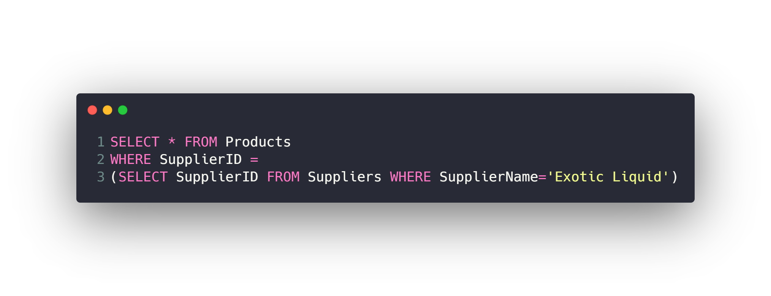
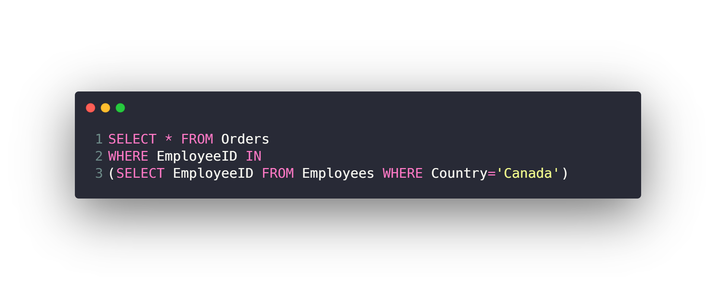
Subqueries

Slide 57
Agenda
What is RDBMS.
Tables, Columns and Data types
How to design a database.
One-To-Many & Many-To-Many Relationships.
Examples: FB, Youtube, Souq.com
SQL
CRUD
Selecting data
Filtering data
Ordering data
Limiting data
Aggregate Functions
Joining tables
Grouping data
Subqueries
Inserting new data
Updating data
Deleting data
Python and SQLite
DB Browser for SQLite

Slide 58
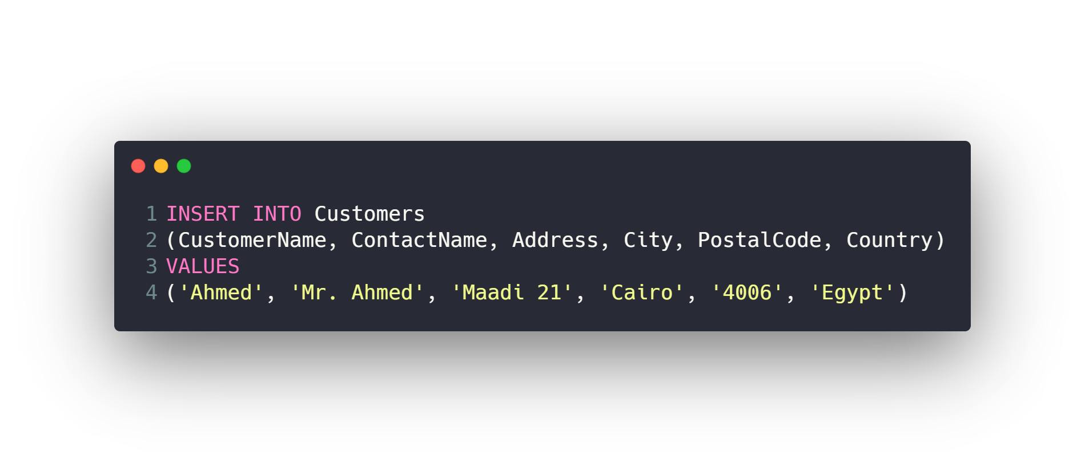
Inserting new data

Slide 59
Agenda
What is RDBMS.
Tables, Columns and Data types
How to design a database.
One-To-Many & Many-To-Many Relationships.
Examples: FB, Youtube, Souq.com
SQL
CRUD
Selecting data
Filtering data
Ordering data
Limiting data
Aggregate Functions
Joining tables
Grouping data
Subqueries
Inserting new data
Updating data
Deleting data
Python and SQLite
DB Browser for SQLite

Slide 60
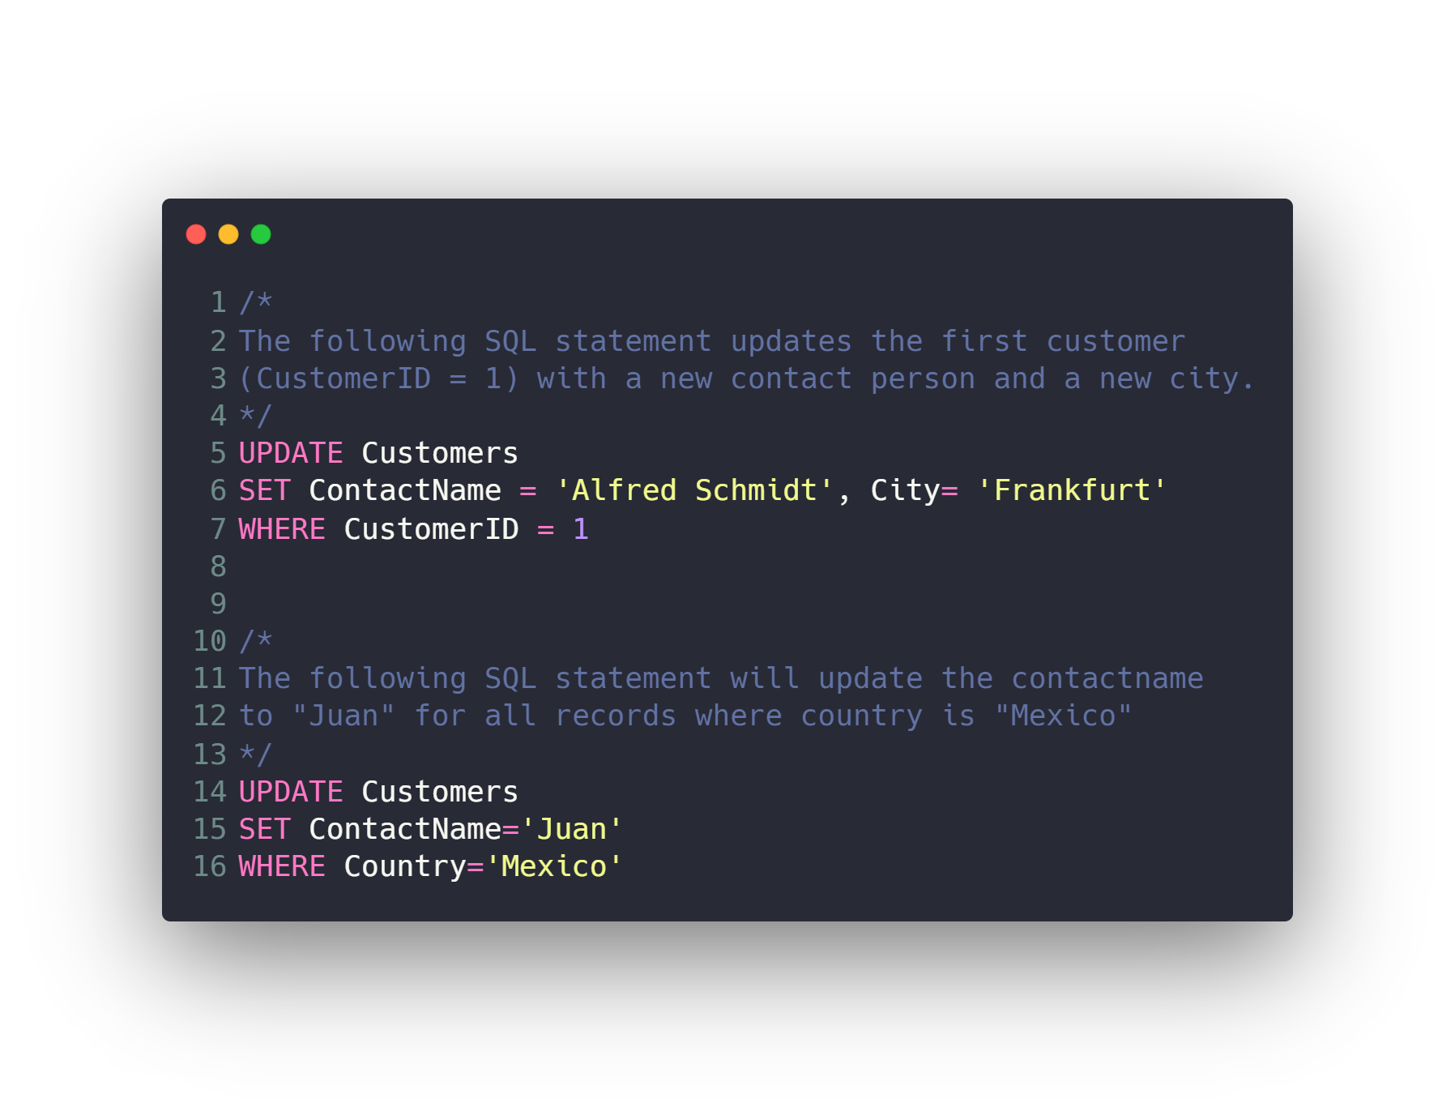
Updating data

Slide 61
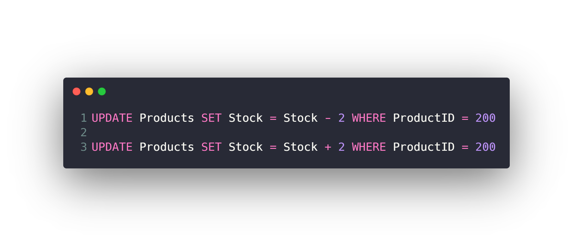
Updating data

Slide 62
Agenda
What is RDBMS.
Tables, Columns and Data types
How to design a database.
One-To-Many & Many-To-Many Relationships.
Examples: FB, Youtube, Souq.com
SQL
CRUD
Selecting data
Filtering data
Ordering data
Limiting data
Aggregate Functions
Joining tables
Grouping data
Subqueries
Inserting new data
Updating data
Deleting data
Python and SQLite
DB Browser for SQLite

Slide 63
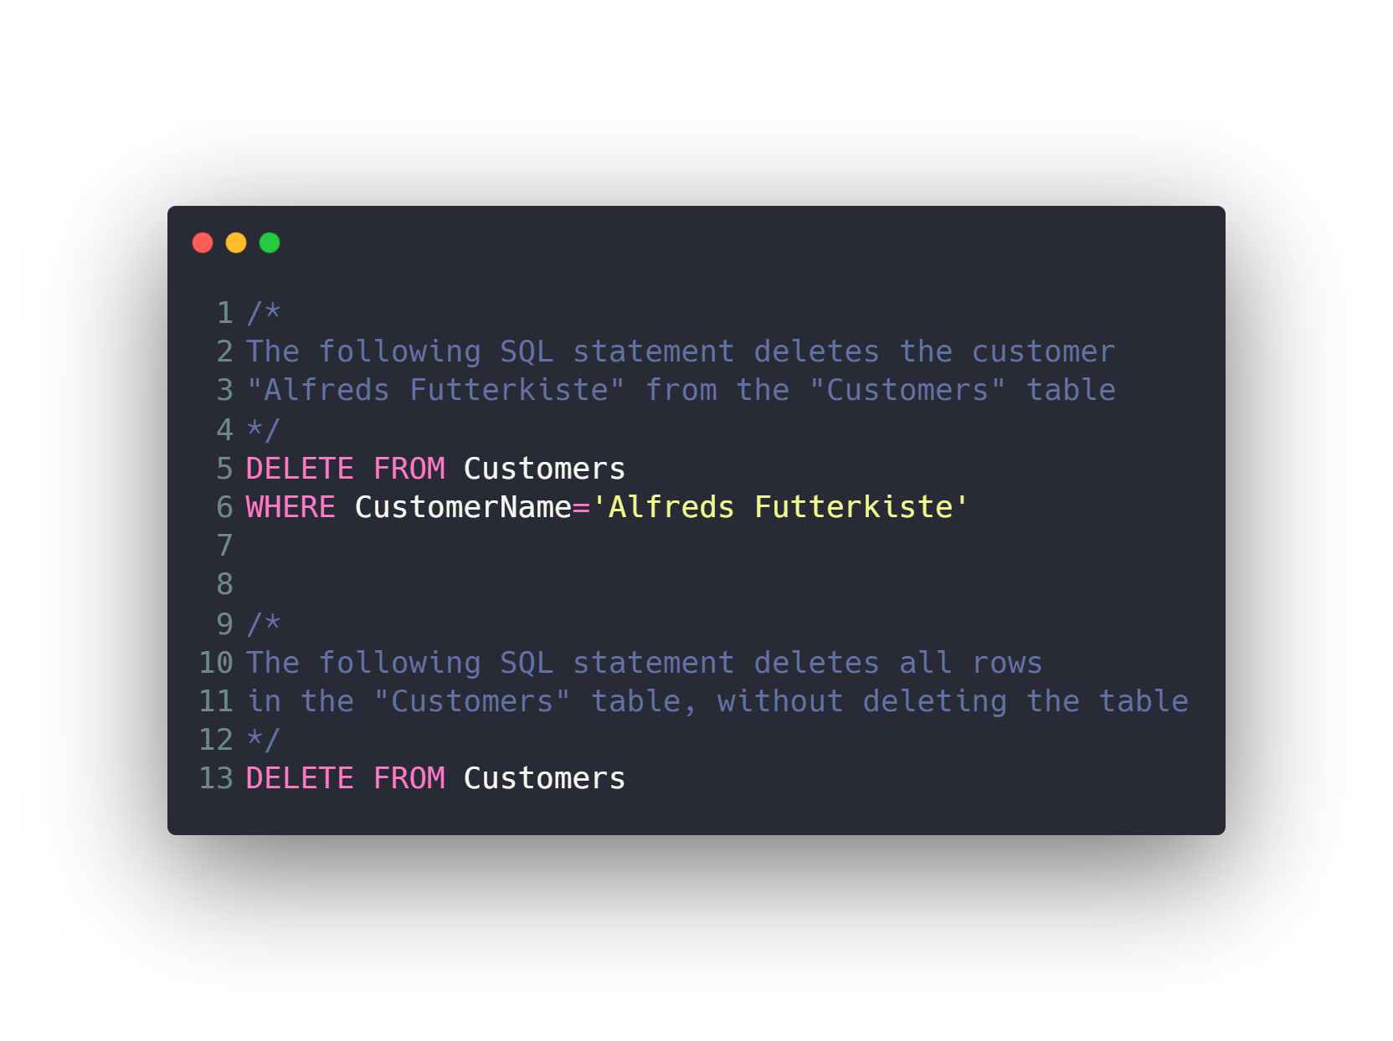
Deleting data

Slide 64
Check Also
Create / Drop / Backup Database
Create / Drop / Alter Table
Constraints (Not Null, Unique, Primary and Foreign Key)
Indexes
Database normalization
Transactions
Triggers & Stored Procedures
Views
SQL Injection
NoSQL
Replication
Shards

Slide 65
Agenda
What is RDBMS.
Tables, Columns and Data types
How to design a database.
One-To-Many & Many-To-Many Relationships.
Examples: FB, Youtube, Souq.com
SQL
CRUD
Selecting data
Filtering data
Ordering data
Limiting data
Aggregate Functions
Joining tables
Grouping data
Subqueries
Inserting new data
Updating data
Deleting data
Python and SQLite
DB Browser for SQLite

Slide 66
Python and SQLite
There is a lot of RDBMS out there
SQLite
MySQL
PostgreSQL
…
We will use SQLite because it’s simple and easy to work with.

Slide 67
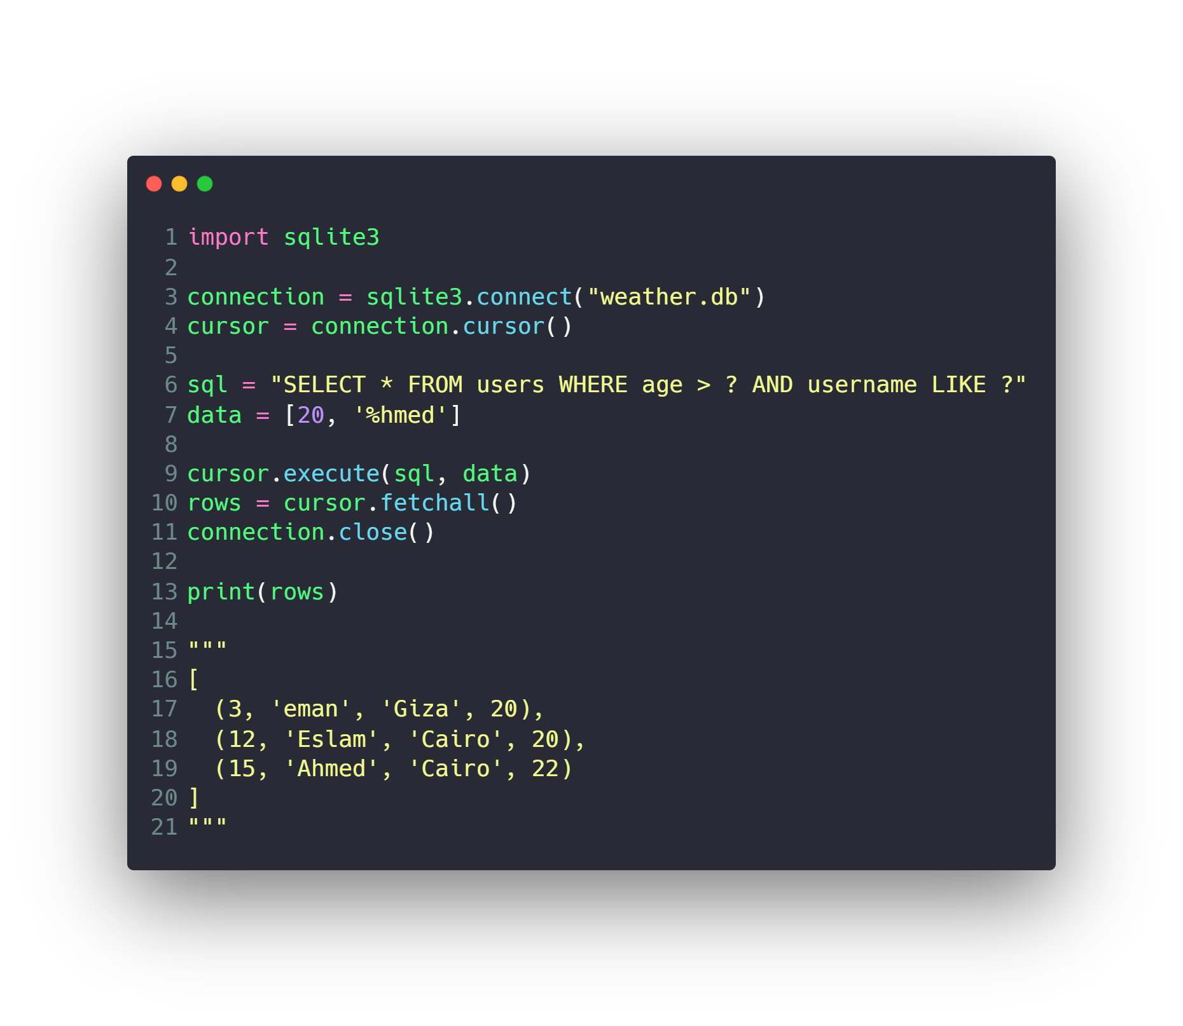
Python and SQLite
Read
Create
Update
Delete

Slide 68
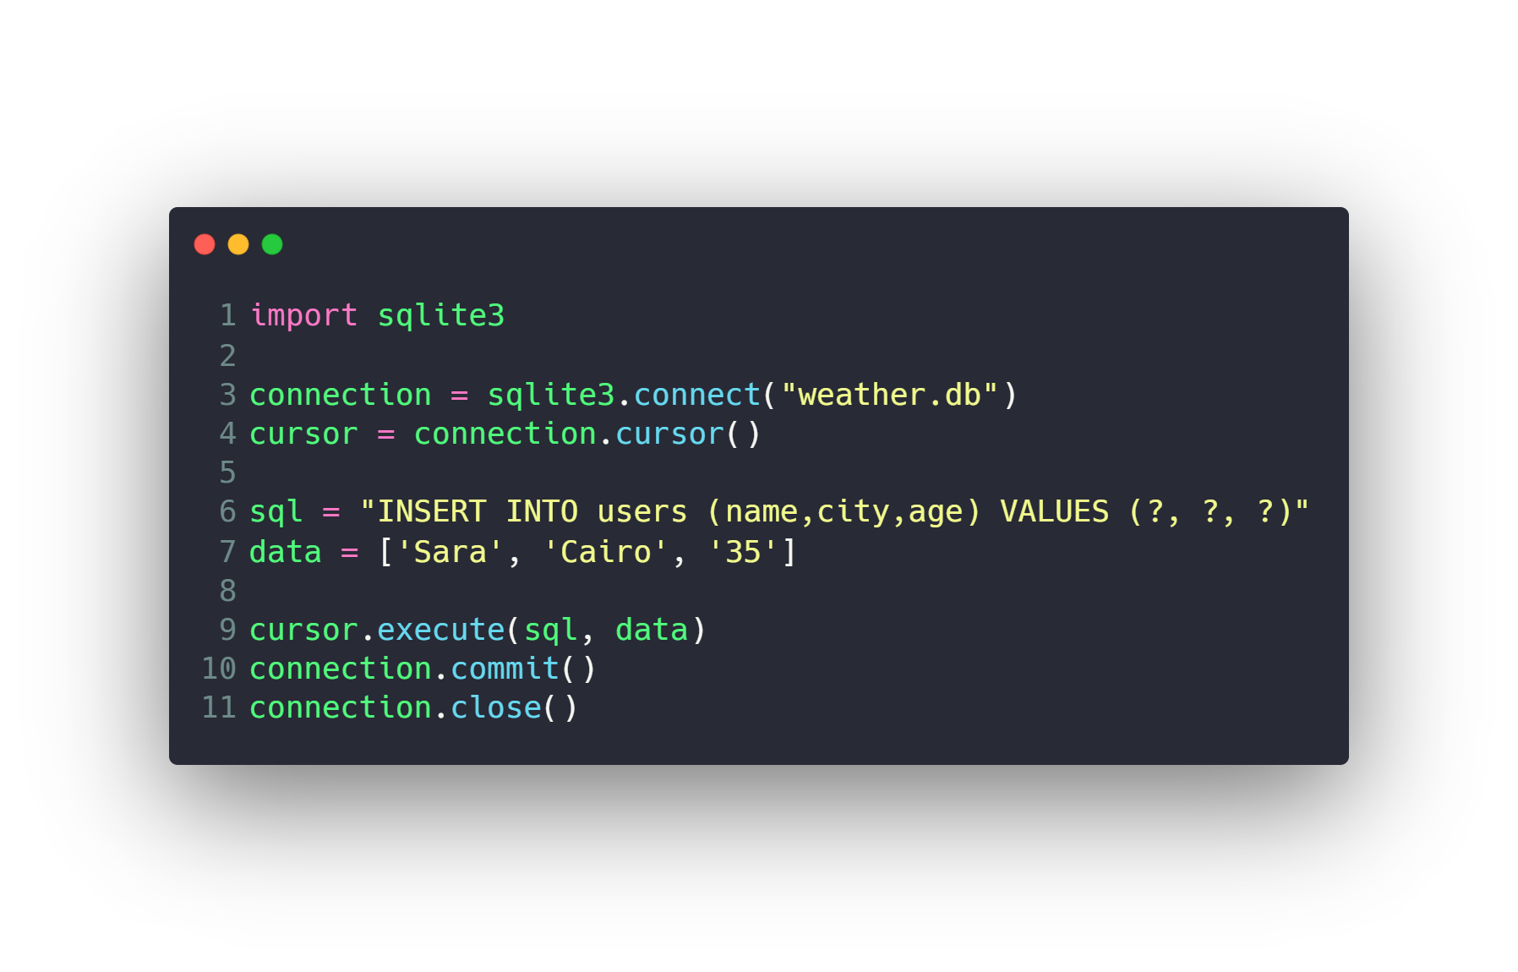
Python and SQLite
Read
Create
Update
Delete

Slide 69
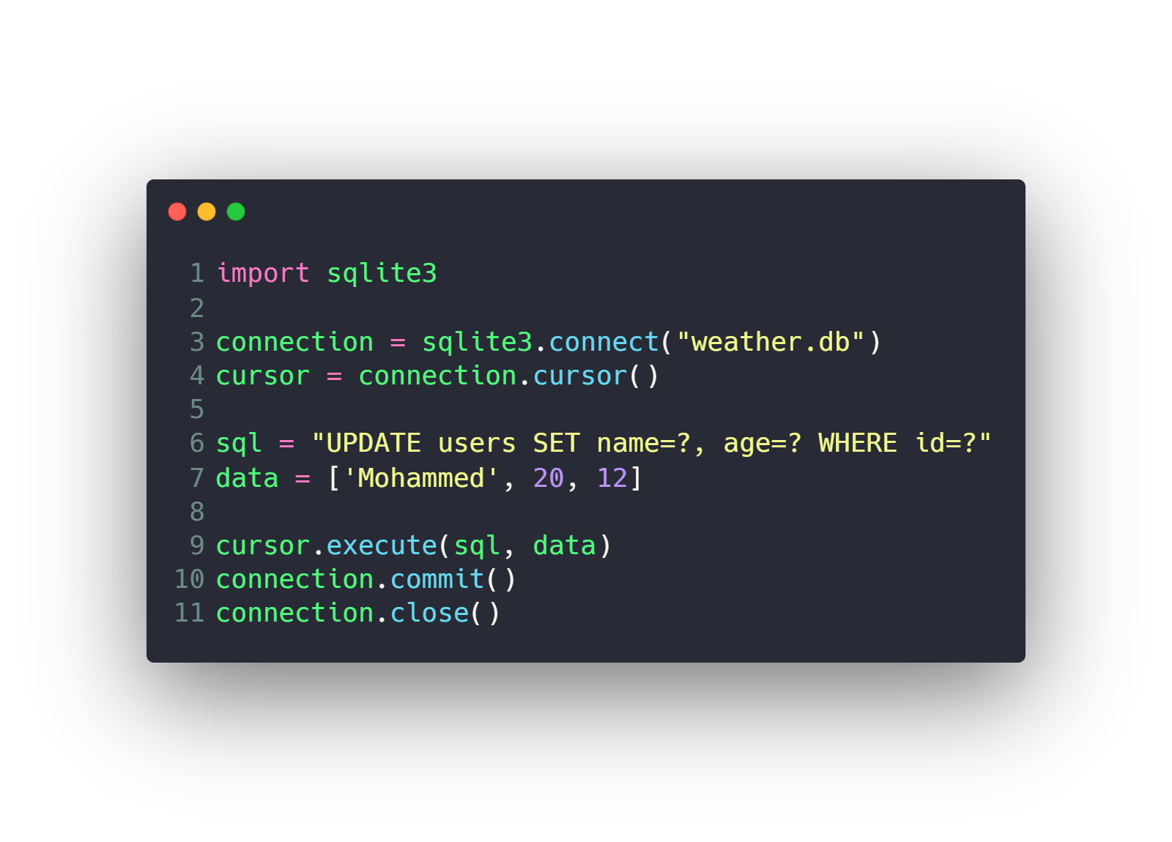
Python and SQLite
Read
Create
Update
Delete

Slide 70
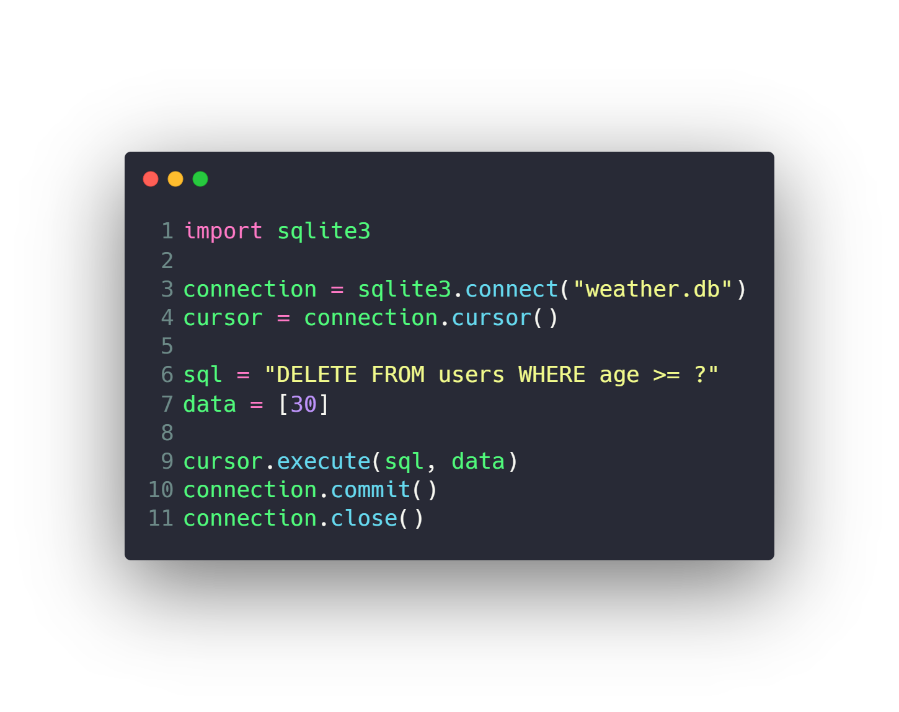
Python and SQLite
Read
Create
Update
Delete

Slide 71
Agenda
What is RDBMS.
Tables, Columns and Data types
How to design a database.
One-To-Many & Many-To-Many Relationships.
Examples: FB, Youtube, Souq.com
SQL
CRUD
Selecting data
Filtering data
Ordering data
Limiting data
Aggregate Functions
Joining tables
Grouping data
Subqueries
Inserting new data
Updating data
Deleting data
Python and SQLite
DB Browser for SQLite

Slide 72
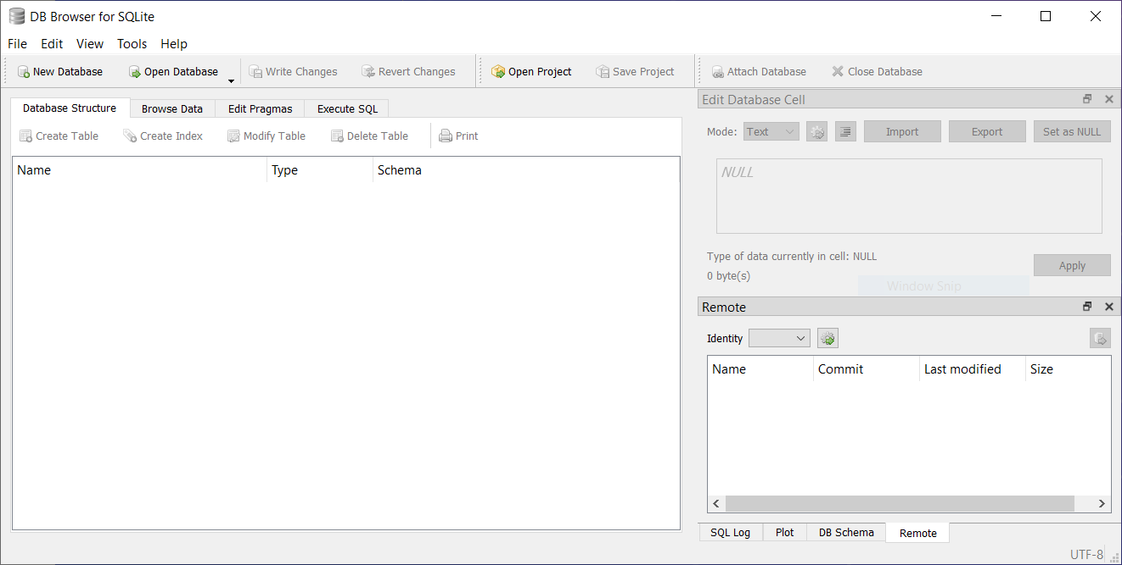
DB Browser for SQLite
GUI to work with SQLite
Download
https://sqlitebrowser.org
Tutorial
https://www.youtube.com/playlist?list=PLU70qqWW4frGdwNh4czgTrCrHvPhyt2aI

Slide 73
DB Browser for SQLite
Open Database
Create Database and tables
Create columns
Modify tables
CRUD with GUI
Execute SQL
Export table to CSV

Slide 74
Questions ?!

Slide 75

Thanks! >_ Live long and prosper

